Slide 1
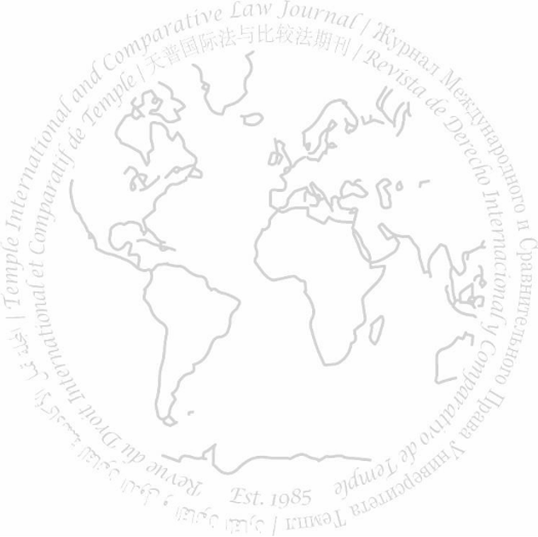
International and Comparative Law Journal VOL. 39
WRITE-ON Training SESSION
MARCH 20, 2024

Slide 2
Access Mock Cite Check

Slide 3
See A. Leon Higginbotham Jr., In the Matter of Colour: Race and the American Legal Process at 170 (Fourth ed. 1980) (discussing status and control of slaves and discriminatory treatment they were subjected to).

Slide 4
See A. Leon Higginbotham Jr., In the Matter of Color: Race and the American Legal Process 170 (4th ed. 1980) (discussing status and control of slaves and discriminatory treatment they were subjected to).
BB R. 15.1 – change author to small caps
BB R. 15.3 – change title to small caps, fix spelling mistake in color.
BB R. 15.4 – change fourth to ^{4th}
BB R. 1.2 – italicize signal

Slide 5
Tony Luong, Supreme Court Will Hear Challenge to Affirmative Action at Harvard and U.N.C., New York Times (December 7, 2023), https://www.nytimes.com/2022/01/24/us/politics/supreme-court-affirmative-action-harvard-unc.html/.

Slide 6
Tony Luong, Supreme Court Will Hear Challenge to Affirmative Action at Harvard and U.N.C., N.Y. Times (Dec. 7, 2023), https://www.nytimes.com/2022/01/24/us/politics/supreme-court-affirmative-action-harvard-unc.html.
Rule 18.2.2(b) – italicize title
R. 18.2.2(b)(i) – abbreviate title according to T6
TICLJ Rule – remove hyper link and remove “/” before period
T12 – abbreviate the month

Slide 7
Neha Jain, A Tale of Two Cities: Reflections on Robinson’s Twinning of International Criminal Law and Criminal Law Theory, 35 Temple International and Comparative Law Journal 25, 34-35 (221) (arguing while Robinson explores the controversies regarding military command responsibility, he overlooks civilian superiors missing an opportunity for analysis and reform).

Slide 8
Neha Jain, A Tale of Two Cities: Reflections on Robinson’s Twinning of International Criminal Law and Criminal Law Theory, 35 Temp. Int’l & Comp. L. J. 25, 34–35 (2021) (arguing while Robinson explores the controversies regarding military command responsibility, he overlooks civilian superiors missing an opportunity for analysis and reform).
BB R. 3.2(a) – Change hyphen to en dash
BB R. 16.4 – Abbreviate journal title according to T6, fix typo in year

Slide 9
Trump v. Anderson, SCOTUSblog, https://www.scotusblog.com/case-files/cases/trump-v-anderson (last visited on Jan. 18, 2023).

Slide 10
Trump v. Anderson, SCOTUSblog, https://www.scotusblog.com/case-files/cases/trump-v-anderson (last visited on [current date]).
BB R. 18.2.2(a) – update last visited date

Slide 11
See OI European Grp. B.V. v. Bolivarian Republic of Venezuela Petroleos de Venezuela, 73 F.4th 157 (Third Circuit. 2023) (holding the denial of sovereign immunity was proper as the Venezuelan government exerted significant economic control over national oil company).

Slide 12
See OI European Grp. B.V. v. Bolivarian Republic of Venezuela Petroleos de Venezuela, 73 F.4th 157 (3rd Cir. 2023) (holding denial of sovereign immunity was proper as Venezuelan government exerted significant economic control over the national oil company).
Rule 10.4(a) – abbreviate circuit court
Rule 10.2 – Remove italics from party names
TICLJ Rule – remove articles from the parenthetical

Slide 13
Allegations of Genocide Under the Convention on the Prevention and Punishment of the Crime of Genocide (Ukraine v. Russian Federation), Order, 2024 I.C.J. No. 182 (Feb. 2) hereinafter ICJ Allegations of Genocide.

Slide 14
Allegations of Genocide Under the Convention on the Prevention and Punishment of the Crime of Genocide (Ukr. v. Russ.), Order, 2024 I.C.J. No. 182 (Feb. 2) [hereinafter ICJ Allegations of Genocide].
Rule 21.5.1(b) and T10.3 – abbreviate party names
R. 4.2(b) – add brackets

Slide 15
Id at 2.

Slide 16
Id. at 2.
BB R. 4.1 – Italicize “Id.” and add period

Slide 17
The Democratic Republic of Congo has faced ongoing conflict and violence, with political tensions, historical conflicts, mining operations, and involvement of foreign powers contributing to a complex and deadly situation. Center for Preventive Action, Conflict in the Democratic Republic of Congo, Council on Foreign Rels. (Dec. 18, 2023), https://www.cfr.org/global-conflict-tracker/conflict/violence-democratic-republic-congo.

Slide 18
The Democratic Republic of Congo has faced ongoing conflict and violence, with political tensions, historical conflicts, mining operations, and involvement of foreign powers contributing to a complex and deadly situation. Center for Preventive Action, Conflict in the Democratic Republic of Congo, Council on Foreign Rels. (Dec. 18, 2023), https://www.cfr.org/global-conflict-tracker/conflict/violence-democratic-republic-congo.
BB R. 1.1 – no changes

Slide 19
ICJ Allegations of Genocide, supra note 6 at 1.

Slide 20
ICJ Allegations of Genocide, supra note 6, at 1.
Rule 4.2 – italicize supra, add comma after note 6

Slide 21
See Deribe Kaske Kacharo, Emebet Teshome & Tesfaye Woltamo (2022) Safety and security of women and girls in public transport, Urban, Planning and Transport Research, 10:1, 1-19, DOI: 10.1080/21650020.2022.2027268, for a feminist perspective on public transportation.

Slide 22
See Deribe Kaske Kacharo et al., Safety and Security of Women and Girls in Public Transport, 10 Urban, Planning &Transp. Rsch 1 for a feminist perspective on public transportation.
BB 16 - the number of the volume should precede the name of the journal, the year should be placed at the end, delete DOI.
BB 1.2(e) -“see” should not be italicized because it works as a verb
BB 16.2 - authors after the first one become “et al.”
BB 16.3 - title should be italicized and capitalized as per BB 8
T6 – abbreviate “and,” transportation, and “research”

Slide 23
Access Answer Key

Slide 24
Research Essay
2-4 Pages
Double Space
Footnotes (~10)

Slide 25
Research Essay Structure
Introduction (1-2 paragraphs)
Thesis (usually 1-2 sentences)
Analysis, Argument, or Research (BULK OF PAPER)
Conclusion (1-2 paragraph)

Slide 26
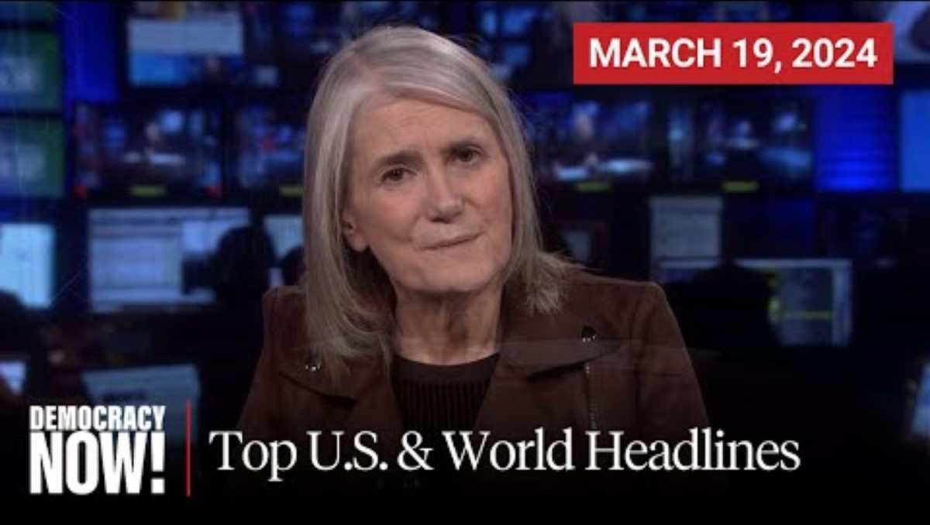
Picking a Topic
Social Media (TikTok, Twitter, Facebook, Instagram, YouTube, etc.)
News Media (New York Times, BBC, Aljazeera, etc.)
Council of Foreign Affairs
Examples
TikTok Ban
Japan high court finds restrictions on "same-sex" marriage unconstitutional
Haiti's Prime Minister resigned

Slide 27
How to Write Essay
Research
Thesis
Outline
Analysis
Introduction
Conclusion

Slide 28
Diversity/Personal Statement
Short
Optional
You don't need to do anything to prepare in advance
More information to come

