Slide 1
Need 2B Needed
Building Social Connections that Matter to Reduce Social Isolation and
Loneliness among Adults with Serious Mental Illness (SMI)
Bryan P. McCormick, PhD
National Institute on Disability, Independent Living and Rehabilitation Research
Disability and Rehabilitation Research Project (90DPCP0011)
College of Physicians of Philadelphia
Public Health Symposium April 3, 2024

Slide 2
Population
Adults with Serious mental illness (SMI)
Include bipolar disorders, major depressive disorders, schizophrenia spectrum disorders
Affect ~5.8% of American adults / 18.8 million people (Bagalman & Napili, 2015).
Experience multiple health disparities and early mortality
Social disconnection contributing factor in early mortality (Fortuna et al., 2023; Holt-Lunstad et al., 2010).
Prevalence of social isolation and loneliness that are significantly greater than the general population of adults (Badcock et al., 2015; Perese & Wolf, 2005).

Slide 3
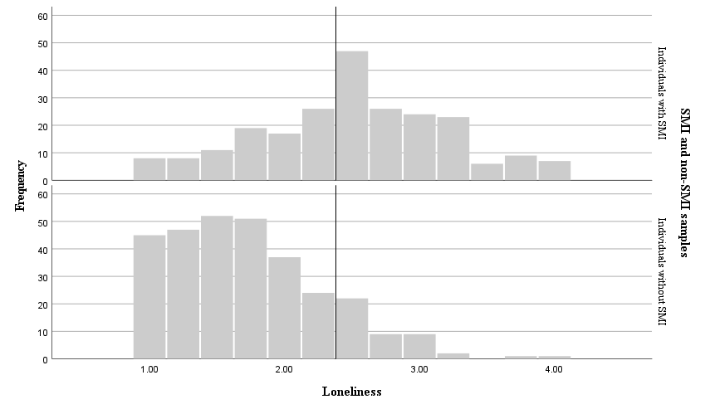
Severity of Loneliness Adults with SMI
Adults with SMI
61.5%
Adults without SMI
10%

Slide 4
Our Approach via Mattering
Loneliness is a symptom- mattering may be an antidote
Mattering is built through positive social connections
One is valued by and important to others
One contributes value to one’s world
Develops in relationships of reciprocity
Receiving & giving support
People with SMI
Limited opportunities to contribute
May not be needed in their environment

Slide 5
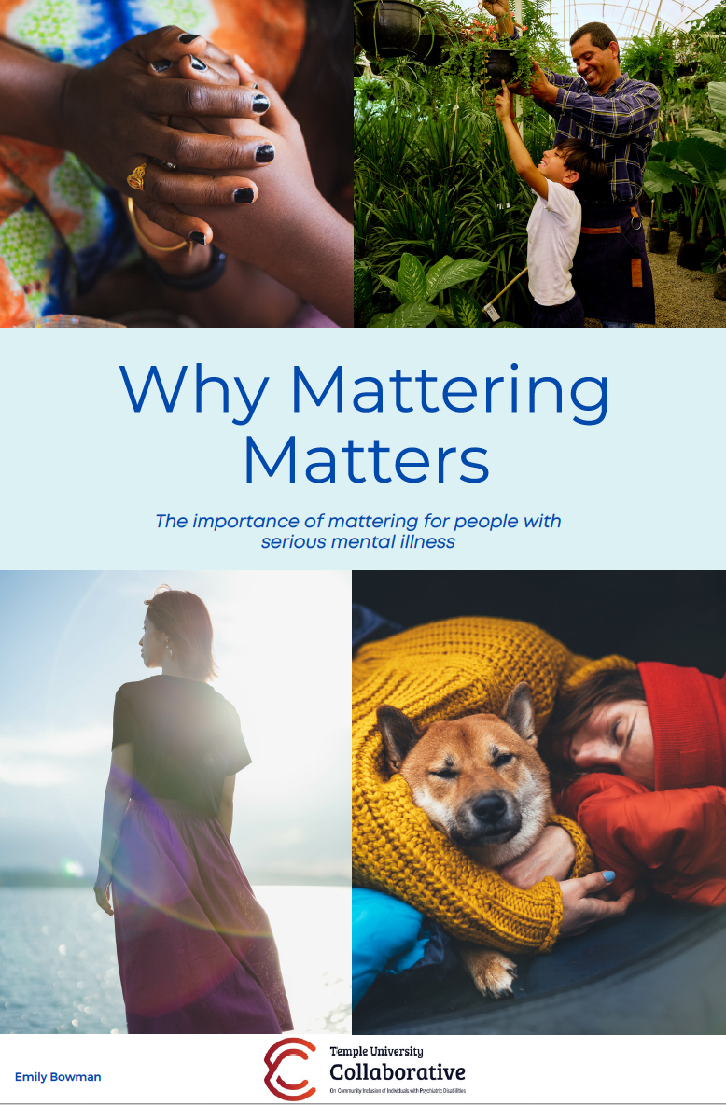
Need2BNeeded Trial
Adults with SMI
Randomized trial w/ attention control condition
12-month Individualized Placement & Support (IPS) Design
Supported volunteerism
Identify interests & explore opportunities
Weekly supports for initiating and sustaining participation
Integration of kindness & gratitude
Targeted Outcome
Increased mattering
Decreased loneliness

Slide 6
Our Team- Temple University Collaborative
Need2BNeeded Disability & Rehabilitation Research Project (DRRP)
Bryan McCormick (PI)
Tabea Neumann (Asst. Research Scientist)
Liz Knight (Research Assistant)
Sabrina Giaimo (Research Assistant)
Laya Koder (BSPH Student worker)
Temple University Collaborative
Mark Salzer (Director, TU Collaborative)
Gretchen Snethen (Assoc. Director, TU Collaborative)
Eugene Brusilovskiy (Director of Data Analysis, TU Collaborative)

Slide 7
The contents of this presentation were developed under a grant from the National Institute on Disability, Independent Living, and Rehabilitation Research (NIDILRR grant number 90DPCP0011-01-00; B. P. McCormick, principal investigator). NIDILRR is a Center within the Administration for Community Living (ACL), Department of Health and Human Services (HHS). The contents of this presentation do not necessarily represent the policy of NIDILRR, ACL, or HHS, and you should not assume endorsement by the Federal Government.

