Slide 1
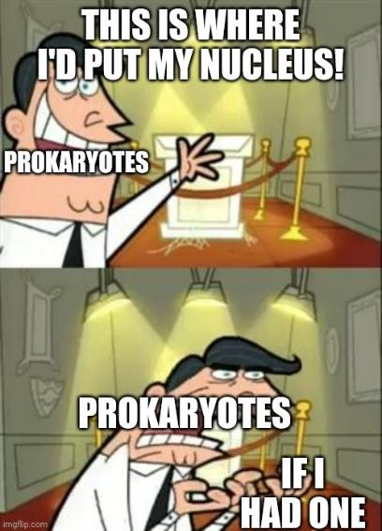
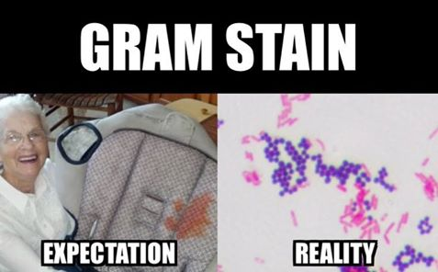
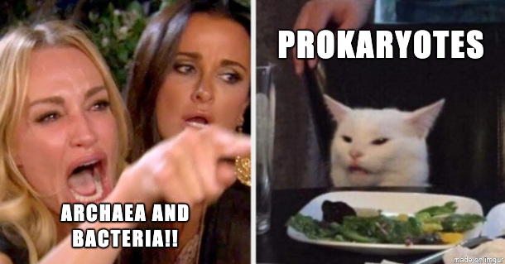
Kaitlyn Grando, Ph.D.
Center for Microbiology & Immunology and Department of Biomedical Education & Data Science
Email:
kaitlyn.grando@temple.edu
Lab: Kresge 504
Health Sciences Campus

Slide 2
Objectives: Basic Bacteriology I
Define the taxonomy of bacteria in the phylogenetic tree, and bacterial naming conventions based on morphology
List the major structures of bacteria (e.g. cell wall, membrane, flagella, fimbriae/pili, capsule, matrix) and their role in bacterial physiology
Compare and contrast prokaryotic vs. eukaryotic cells
Explain the process of Gram-staining and the structures that are differentiated in Gram-positive vs. Gram-negative bacteria
Notes:
Take special note of terms/facts written in BOLD

Slide 3
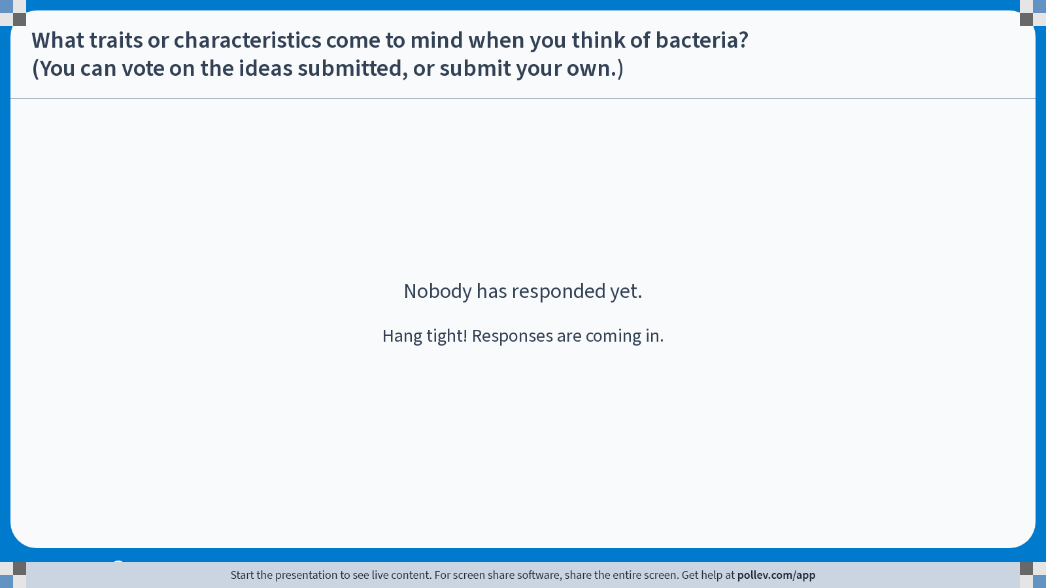
Poll Everywhere Q&A activity
Activity Title: What do you think are some traits or characteristics of bacteria? (You can vote on the ideas submitted, or submit your own.)
Slide 4
Notes:
Do not modify the notes in this section to avoid tampering with the Poll Everywhere activity.
More info at polleverywhere.com/support
What do you think are some traits or characteristics of bacteria? (You can vote on the ideas submitted, or submit your own.)
https://www.polleverywhere.com/discourses/3yt9ddpWlePQVzkG9ojk2

Slide 4
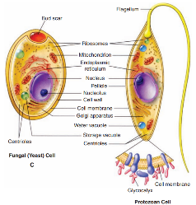
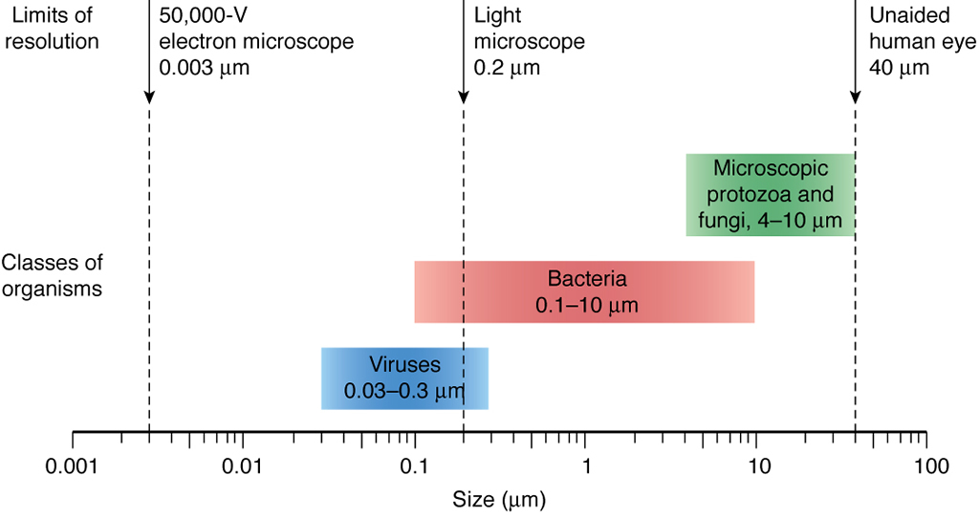
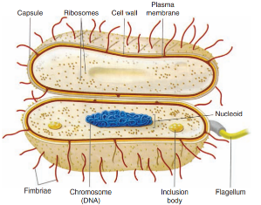
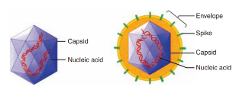
Types of microbes
worms – macroscopic
Sherris Medical Microbiology, 6th edition

Slide 5
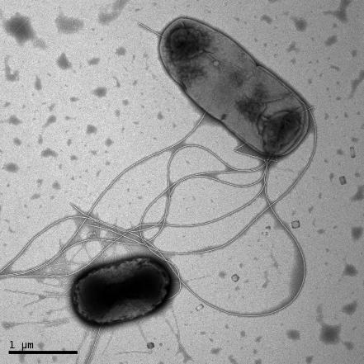
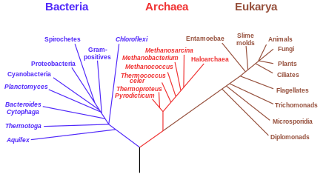
Bacterial taxonomy determined by phylogeny (evolution)
Prokaryotes – single celled organism with no nucleus nor organelles
Domain Bacteria
Kingdom Bacteria
Phylum Pseudomonadota
Class Gammaproteobacteria
Order Enterobacterales
Family Enterobacteriaceae
Genus Escherichia
Species coli
(Serotype/Strain) O157:H7
Dagmara Kisiela /University of Washington

Slide 6
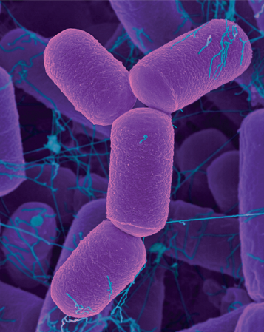
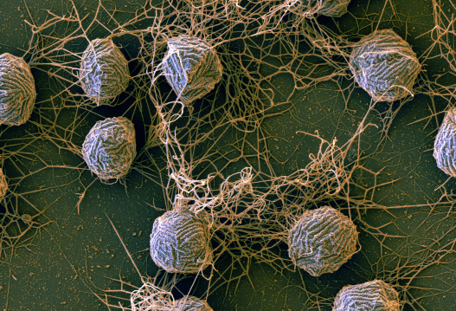
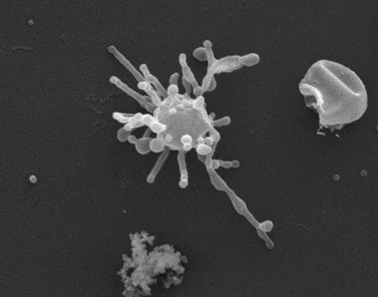
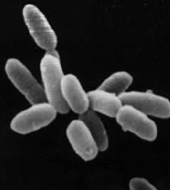
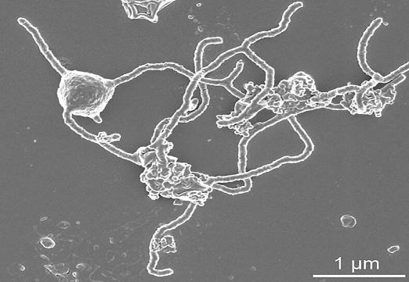
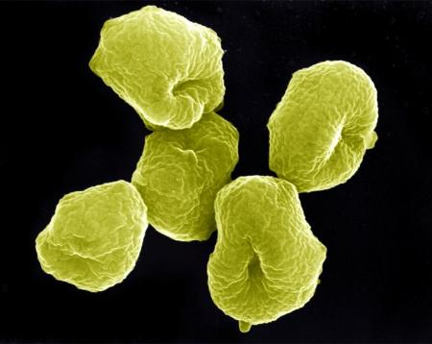
Archaea
Methanocaldococcus villosus
Methanobrevibacter smithii
Lokiarchaeum ossiferum
Promethearchaeum syntrophicum
Sulfolubus sp.
Halobacterium salinarum
Gross, Curr Biol, 2018; PHOTO: DENNIS KUNKEL MICROSCOPY/SCIENCE SOURCE; Rodrigues-Oliveira et al., Nature, 2023
Imachi et al, Nature, 2020; Servick, Science News, 2021
Notes:
Image from https://science.nasa.gov/science-news/science-at-nasa/2004/10sep_radmicrobe

Slide 7
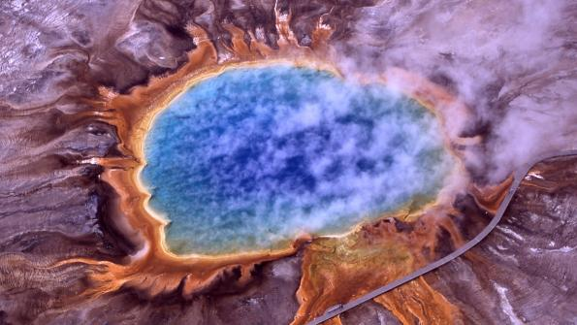
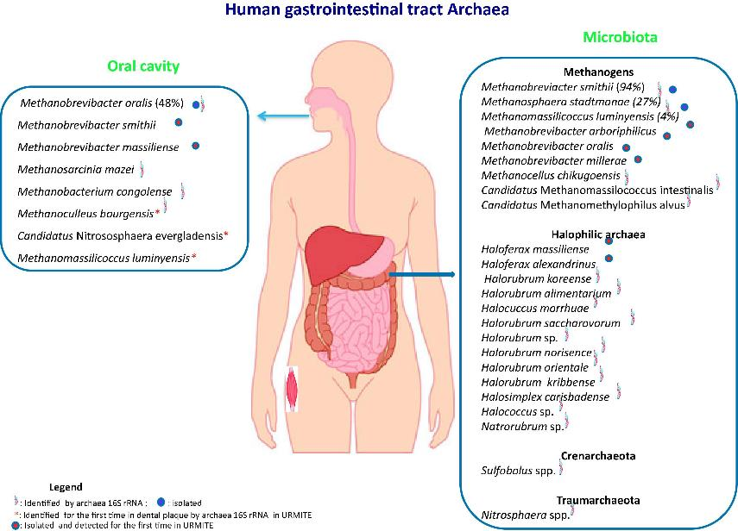
Archaea characterized by:
Able to use alternative energy sources like inorganic molecules or sunlight (photosynthesis)
Often extremophiles (but not always!)
Grand Prismatic Spring in Yellowstone (National Park Service)
Bacteria
Eukaryotes
Prokaryotes
Similar RNA polymerase
1 circular chromosome
Binary fission/budding
Simplified histones
Similar cell structures
Archaea
Nkamga, Henrissat, and Drancourt, Human Microbiome Journal, 2017

Slide 8
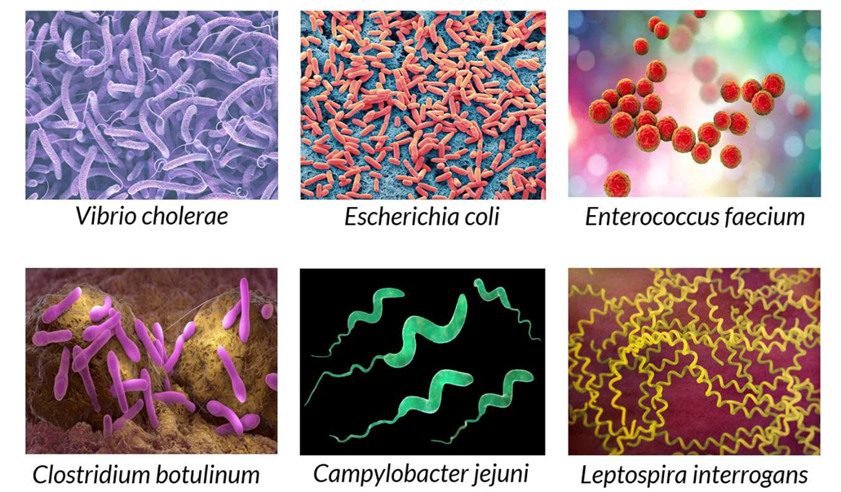
Bacteria
Goldberg, M. (2024, August 29). Introduction to microbiology 1 [Video file]. In The Biomedical & Life Sciences Collection, Henry Stewart Talks.

Slide 9
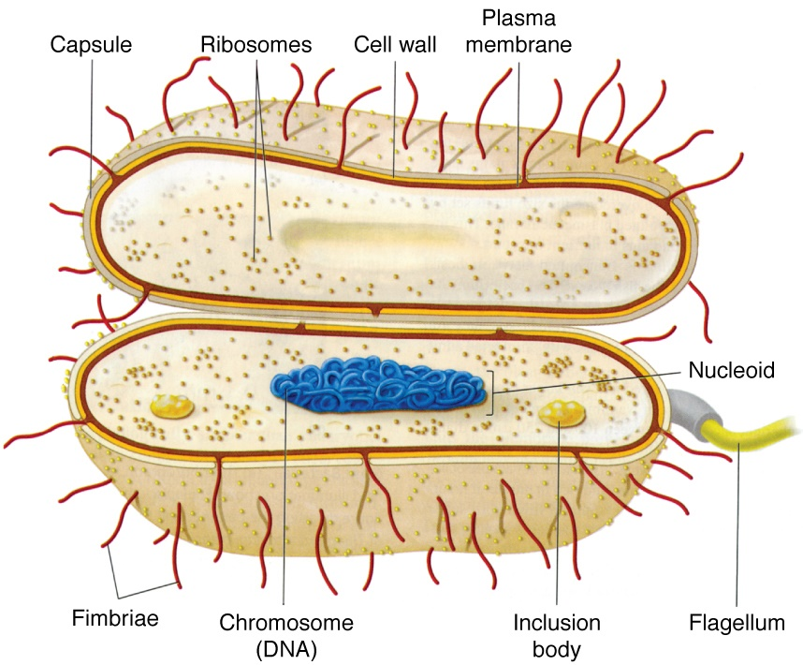
Bacterial Cell Structures
Smaller size: (Bacteria: 0.1-10 microns; Eukaryotes: 10-100 microns)
No membrane-bound organelles:
  Circular chromosome in nucleoid
  No ER – transcription and translation coupled
  No mitochondria – electron transport chain on cell membrane
Ribosomes (Bacteria: 30S/50S;
Eukaryotes: 40S/60S)
Cell wall and cell membrane (Envelope)
Other external structures (species specific): capsule, matrix, flagella, fimbriae/pili
Sherris Medical Microbiology, 6th Edition

Slide 10
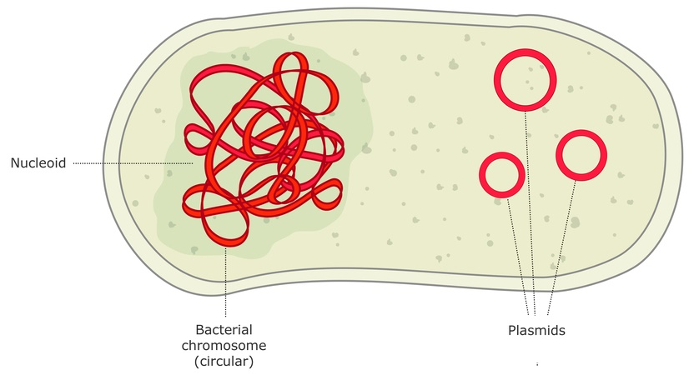
Bacterial DNA
Circular DNA in nucleoid
  Packaged by supercoiling
  Haploid genome – single chromosome
Plasmids – extrachromosomal DNA
The University of Waikato Te Whare Wānanga o Waikato, Science Learning Hub

Slide 11
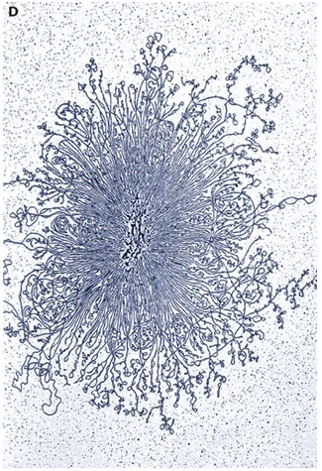
DNA is compacted to fit in the bacterial cell
Most bacterial chromosomes are circular
Supercoiling compacts DNA
Histone-like proteins protect, bend, and bridge DNA
Histone-like proteins
Structural maintenance complexes
Wang, Llopis, and Rudnerl, Nat Rev Genetics, 2013
Notes:
a | Schematic representation of the bottlebrush model of the nucleoid. This diagram depicts the interwound supercoiled loops emanating from a dense core. The topologically isolated domains are on average 10 kb and therefore are likely to encompass several branched plectonemic loops.
b | Schematic representation of the small nucleoid-associated proteins and the structural maintenance of chromosome (SMC) complexes. These proteins introduce DNA bends and also function in bridging chromosomal loci.
d | A gently isolated E. coli nucleoid bound by cytochrome C, spread on an electron microscope grid, stained with uranyl acetate and visualized by transmission electron microscopy.

Slide 12
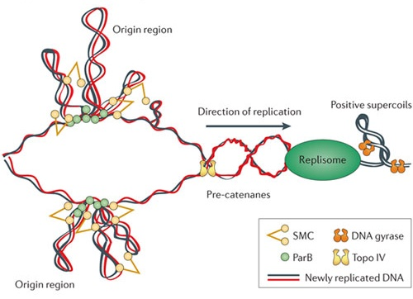
Gyrase and topoisomerase IV allow for DNA replication
DNA gyrase - negative supercoils to counteract positive supercoils introduced by replication fork
Topoisomerase IV - cuts new daughter DNA behind replication fork to prevent interlocking circular chromosomes (“catenanes”)
FYI: Novobiocin and quinolones/fluoroquinolones (antibiotics) target DNA gyrase
Topo IV
DNA gyrase
Wang, Llopis, and Rudnerl, Nat Rev Genetics, 2013
Notes:
c | The diagram depicts replication fork progression and compaction of the origin region. Replication generates positive supercoils ahead of the fork, which can diffuse behind the replisome, producing pre-catenanes. Positive supercoils are removed by DNA gyrase and topoisomerase IV (Topo IV), and pre-catenanes are unlinked by Topo IV. Newly replicated origin regions are thought to be compacted by the SMC complexes that are recruited to the origin by ParB and by the action of small nucleoid-associated proteins (not shown).

Slide 13
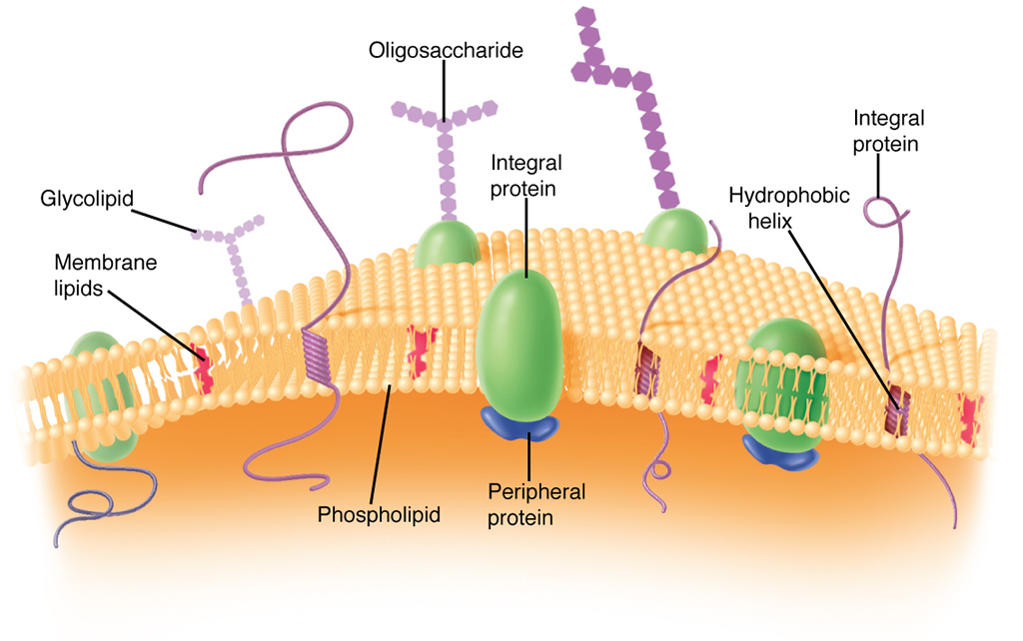
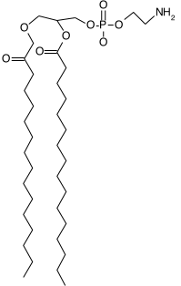
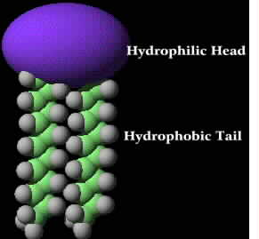
Envelope: Cell Membrane
composed of phospholipids
phosphotidylethanolamine (PE) and phosphotidylglycerol (PG)
Lack of sterols (except Mycoplasma, which take sterols from environment) causes
weaker plasma membranes more prone to lysing than eukaryotic cells
Sherris Medical Microbiology, 6th Edition
Notes:
Different phospholipids in bacterial cell membrane vs. eukaryotic
Plus other membrane associated proteins, polysaccharides, lipids, etc

Slide 14
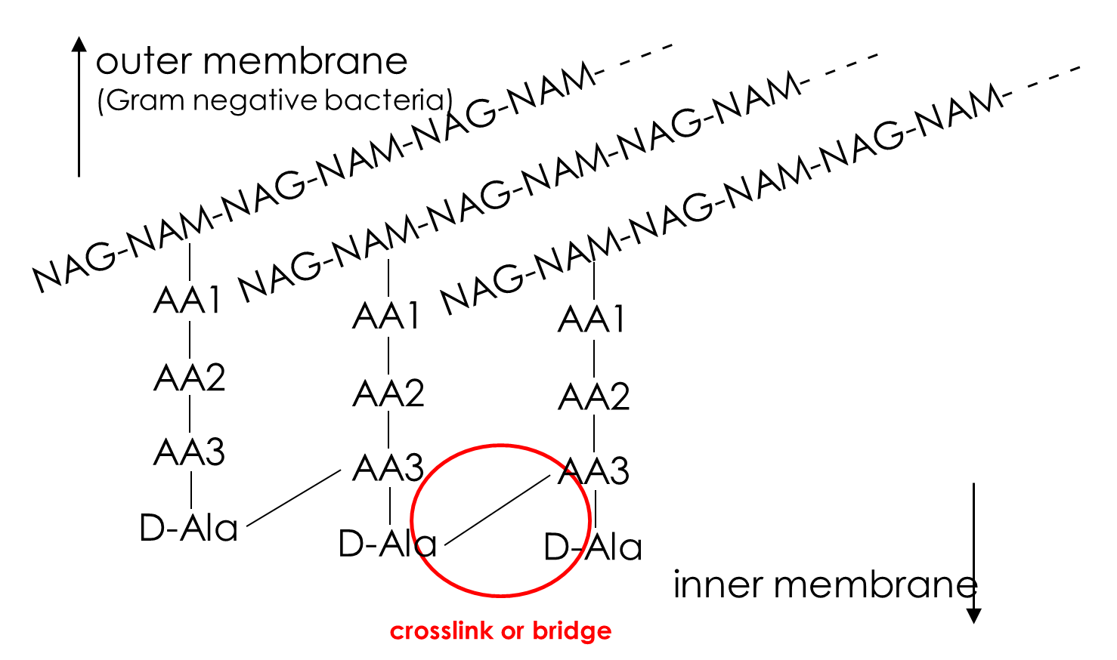
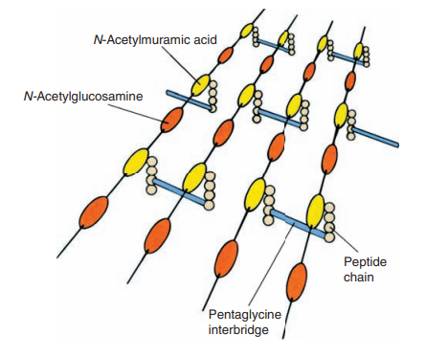
Envelope: Cell Wall
Composed of peptidoglycan
  Resistance to lysis
  Confers shape (e.g. cocci vs. bacilli)
(NAM)
(NAG)
FYI: β-lactams and vancomycin antibiotics inhibit crosslinking of peptidoglycan cell wall
Sherris Medical Microbiology, 6th Edition
Notes:
Peptidoglycan – polysaccharide chains cross linked with peptides making up bacterial cell wall

Slide 15
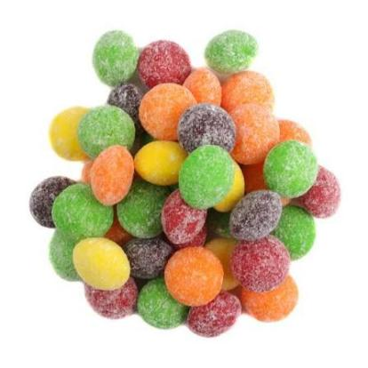
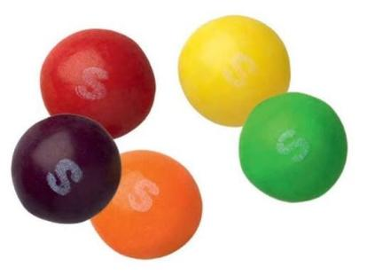
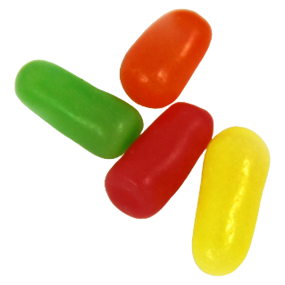
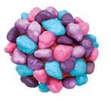
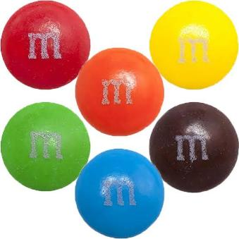
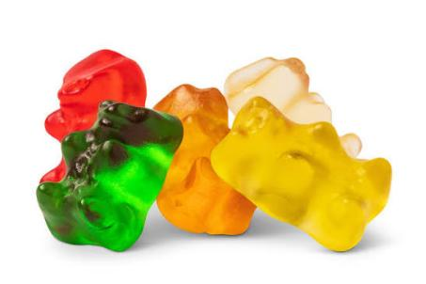
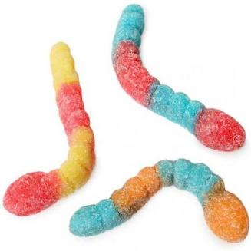
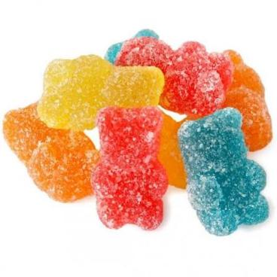
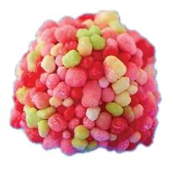
Activity: Imagine you are one of the first microbiologists discovering and categorizing and naming these tiny creatures.
How would you sort them? How would you name them?

Slide 16
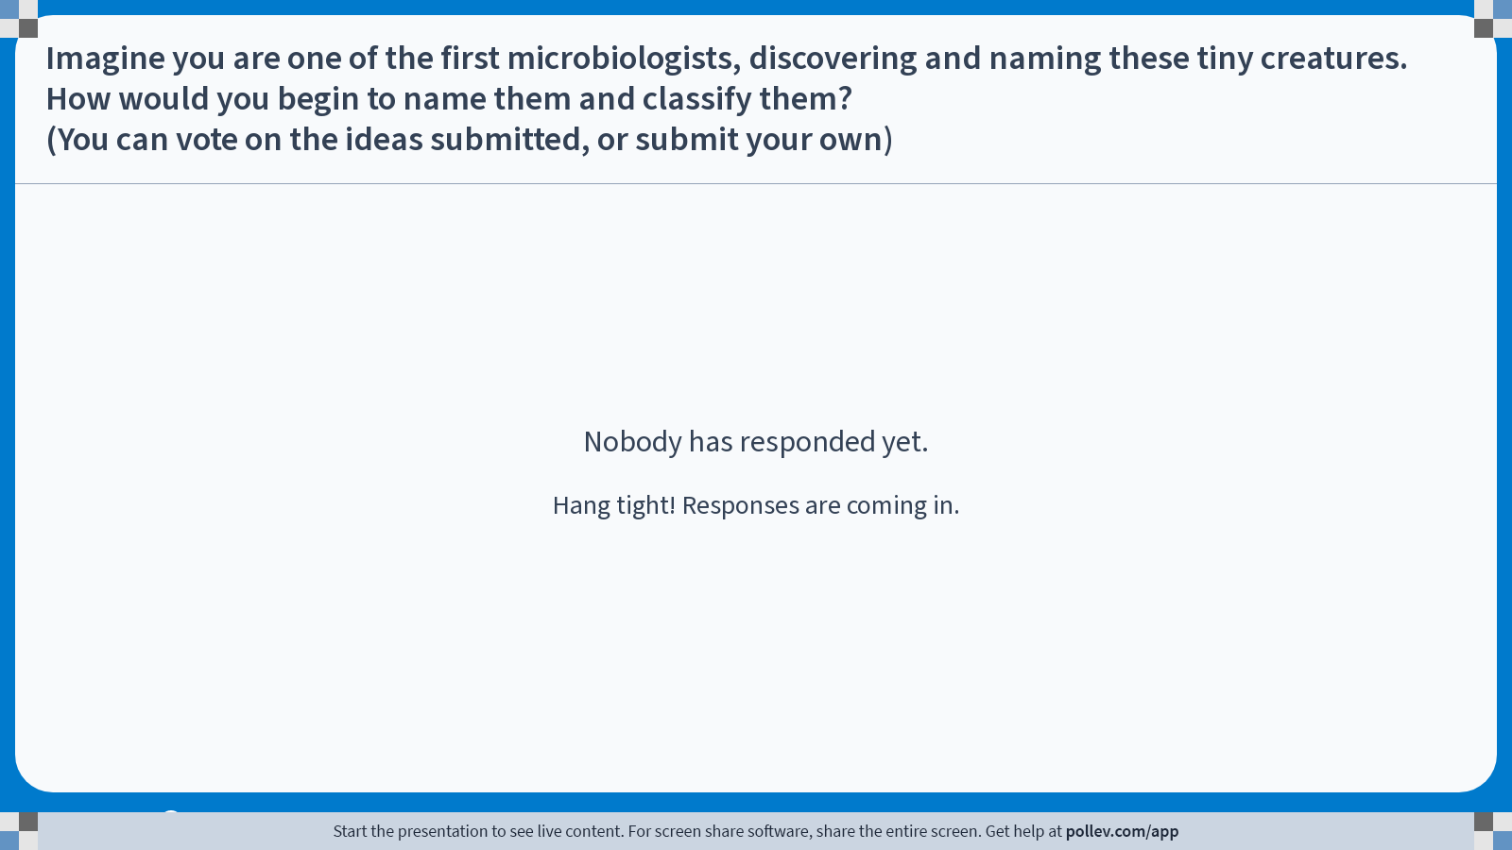
Poll Everywhere Q&A activity
Activity Title: Imagine you are one of the first microbiologists, discovering and naming these tiny creatures. How would you begin to name them and classify them? (You can vote on the ideas submitted, or submit your own)
Slide 16
Notes:
Do not modify the notes in this section to avoid tampering with the Poll Everywhere activity.
More info at polleverywhere.com/support
Imagine you are one of the first microbiologists, discovering and naming these tiny creatures. How would you begin to name them and classify them? (You can vote on the ideas submitted, or submit your own)
https://www.polleverywhere.com/discourses/bVDEi0pwKCk2DVj6WKh5F

Slide 17
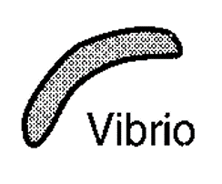
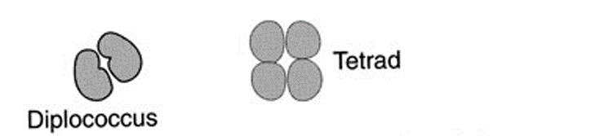
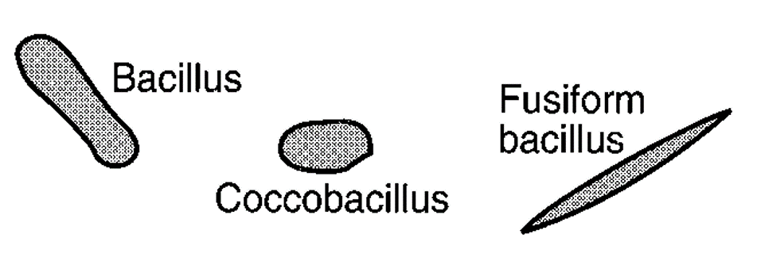
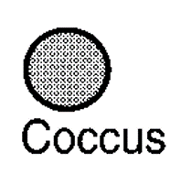
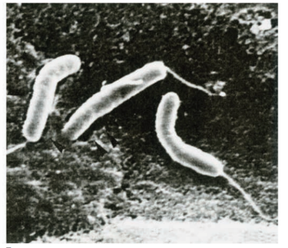
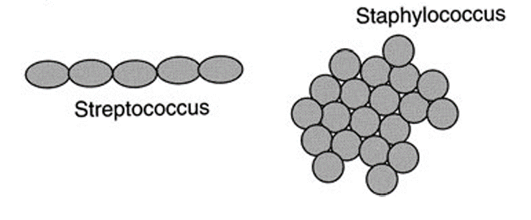
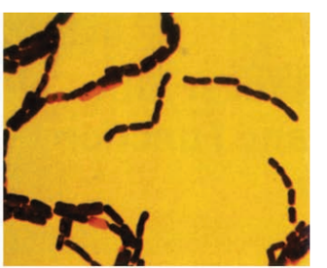
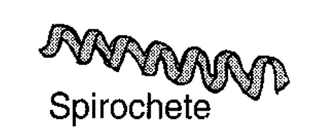
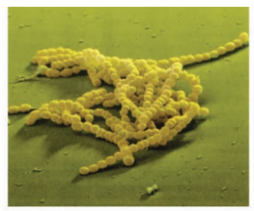
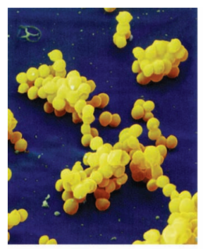
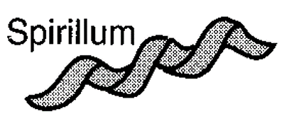
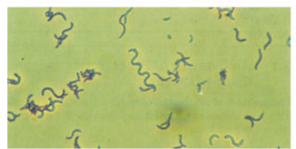


Bacterial shapes and nomenclature
Vibrio cholerae
Bacillus anthracis
Rhodospirillum rubrum
Streptococcus agalactiae
Staphylococcus aureus
Filamentous
Pleomorphic
Sherris Medical Microbiology, 6th Edition

Slide 18








Gram staining
Staphylococcus aureus
E. coli
Sherris Medical Microbiology, 6th Edition
Notes:
Useful categorization of bacteria

Slide 19






Gram staining protocol
safranin
Sherris Medical Microbiology, 6th Edition

Slide 20
Some important organisms that
do not stain well with Gram reagents:
Organism | How visualized | Comment
Mycobacteria | Acid-fast stain | High lipid content in wall.
Mycoplasma, Ureaplasma | Culture and patient serology used for ID. | Lack cell wall. Too small for standard light microscopy
Rickettsia, Chlamydia | Gimenez, Giemsa, or Indirect Immunofluorescence to confirm, DNA probes or PCR (Visualization not routine for diagnosis) | Obligate intracellular parasites. Gram⁻ cell wall structure.
Spirochetes | Darkfield microscopy used to be standard. Still used for Leptospira. Treponema and Borrelia use ELISA. | Most are too slender for standard light microscopy.
We’ll talk more about these later…

Slide 21

Gram Positive Bacteria
Protein
Thick peptidoglycan layer
Interspersed lipoteichoic acid (LTA)
  Specific to Gram positive
  Elicits immune response
  Confer negative charge
Can have other proteins covalently attached to peptide side chain
(cell-wall anchored proteins)
Sherris Medical Microbiology, 6th Edition

Slide 22

Gram Negative Bacteria
Thin peptidoglycan layer
Outer membrane contains
  lipopolysaccharide (LPS)
  (aka endotoxin)
  Porins for transport

Slide 23

Endotoxin (Lipopolysaccharide; LPS)
Specific to Gram-negative
Composed of:
  O-side chain
  Core polysaccharide
  Lipid A
Wide variability between and within species
Elicits a potent immune response (we’ll talk about sepsis later…)
Sherris Medical Microbiology, 6th Edition
Notes:
Remember, Gram negative!
As you learn about pathogens, LPS is very important for virulence!
For example, when a patient has sepsis, LPS is often the culprit, causing a severe uncontrolled immune response that can be fatal

Slide 24

Poll Everywhere multiple choice poll instructions screen
Activity Title: Select the correct statement regarding bacterial cell walls:
Slide 24
Notes:
Do not modify the notes in this section to avoid tampering with the Poll Everywhere activity.
More info at polleverywhere.com/support
Select the correct statement regarding bacterial cell walls:
https://www.polleverywhere.com/multiple_choice_polls/aZ0LN8Rlawh8L4Ut8B76D?display_state=instructions&activity_state=opened&state=opened&flow=Engagement&onscreen=persist

Slide 25


Capsule
= discrete layer associated with individual cells
Klebsiella pneumoniae
mediate adherence
protect from phagocytosis and block complement (alternative pathways)
protect from drying
Streptococcus pneumoniae
Sherris Medical Microbiology, 6th Edition
Notes:
Often made of polysaccharides

Slide 26


Matrix
(aka slime layer) = secreted layer which embeds community of bacteria
Pseudomonas aeruginosa infected catheter
Biofilm Engineering Group - Calgary Centre for Innovative Technology
MRSA infected catheter
scaffolding for formation of biofilms
reserve of carbohydrate for subsequent metabolism
Notes:
(I’ll talk a little more about biofilms in the next lecture)
Can be made of proteins, extracellular DNA, polysaccharides

Slide 27

Other extracellular structures
Pili/Fimbriae – (often interchanged e.g. E. coli common pili = type I fimbriae)
Flagella:
Motility (powered by proton motive force)
Sometimes attachment
composed of proteins
composed of flagellin
Pili/Fimbriae:
attachment
conjugation (DNA exchange)
motility (gliding and twitching)
Sherris Medical Microbiology, 6th Edition

Slide 28

Poll Everywhere multiple choice poll activity
Activity Title: Eukaryotes and prokaryotes share which of the following cell structures? (Even if the composition of said structures is not identical)
Slide 33
Notes:
Do not modify the notes in this section to avoid tampering with the Poll Everywhere activity.
More info at polleverywhere.com/support
Eukaryotes and prokaryotes share which of the following cell structures? (Even if the composition of said structures is not identical)
https://www.polleverywhere.com/multiple_choice_polls/yL32DYgSG70mHZl9JByZl?state=opened&flow=Default&onscreen=persist

Slide 29

Poll Everywhere multiple choice poll activity
Activity Title: You observe an unknown sphere-shaped bacterium under the microscope, which of these options may be its name?
Slide 31
Notes:
Do not modify the notes in this section to avoid tampering with the Poll Everywhere activity.
More info at polleverywhere.com/support
You observe an unknown sphere-shaped bacterium under the microscope, which of these options may be its name?
https://www.polleverywhere.com/multiple_choice_polls/STseUM6jRyyWwBO26eD43?state=opened&flow=Default&onscreen=persist

