Slide 1
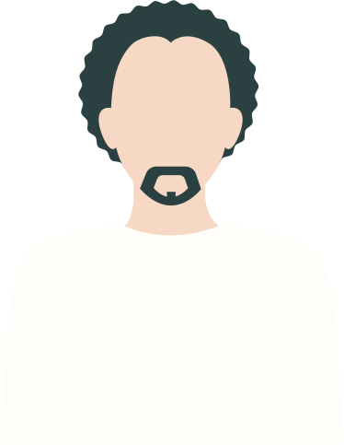
Looking After
Our Mental Health
A health education lesson on suicide prevention
By: Nicole Washington & Meghan Buckley

Slide 2
Ground Rules
Listen with an open mind
One person speaks at a time
Be considerate of each others' feelings
Avoid insulting other students
Try not to stereotype
Honor confidentiality

Slide 3
Objectives
After this lesson, the participants will be able to list at least two warning signs of suicide among their peers​​.
1
After this lesson, participants will be able to indicate that they believe no one should be ashamed to get help for having suicidal thoughts.
2
3
After this lesson, participants will be able to identify a trusted resource that they can turn to for help.

Slide 4
What is
Suicide Prevention?
Activities implemented and actions taken before a suicide occurs that are designed to reduce the risk of suicide

Slide 5
How Do You Take
Care Of Your
Mental Health?

Slide 6
PHYSICAL
5 TYPES OF
SELF CARE
EMOTIONAL
SOCIAL
ENVIRONMENTAL
SPIRITUAL

Slide 7
Risk Factors
Previous suicide attempt
Risk factors are things that increase the likelihood that a person will begin to have suicidal thoughts.
Mental illness
Feeling homesick
Social isolation
Feeling hopeless and helpless

Slide 8
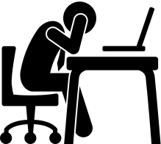
Risk Factors
Stress
Risk factors are things that increase the likelihood that a person will begin to have suicidal thoughts.
Being afraid to ask for help
Sexual assault and violence
Frequent drug and alcohol use
Knowing somone who died from suicide

Slide 9
University Leads Statewide Task Force To Create Suicide Prevention Video

Slide 10
What could you do to prevent the person in the case study from committing suicide?
What are the warning signs that you notice?

Slide 11
Resources Available On Temple's Campus
Tuttleman Counseling Services
Wellness Resource Center

Slide 12
POST ASSESSMENT

Slide 13
RESOURCES
Suicide Prevention Resource Center
Tuttleman Counseling Service
Wellness Resource Center
National Suicide Prevention Lifeline
Crisis Intervention Hotline

Slide 14
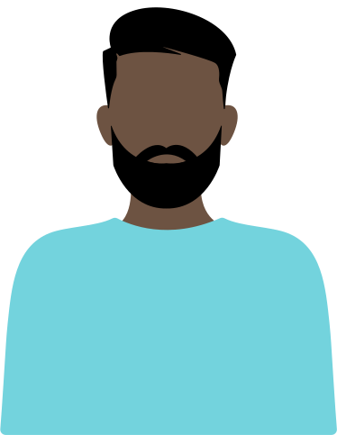
Thank you!
ANY QUESTIONS?

