Slide 1
Climate Change: A Global Crisis
Ally Byrne and Lisa Chemplayil

Slide 2
Introduction
Objectives
At the completion of this lesson, participants will be able to name causes of climate change on a post test.
At the completion of this lesson, participants will be able to name one way to prevent climate change on a post test.

Slide 3
What is Climate Change?
Climate change is a change in the usual weather found in a place. This could be a change in how much rain a place usually gets in a year or it could be a change in a place's usual temperature for a month or season.

Slide 4
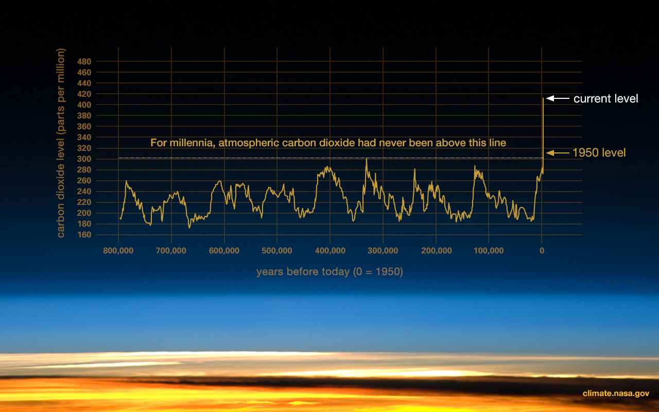
Scientific Evidence for Climate Change
Overall global shifts in weather
Extreme weather phenomena
Evidence
Ice Cores
Tree Rings
Ocean Sediment
Coral Reef
Sedimentary Rocks

Slide 5
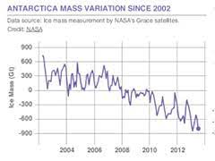
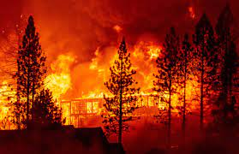
Scientific Evidence for Climate Change (cont.)

Slide 6
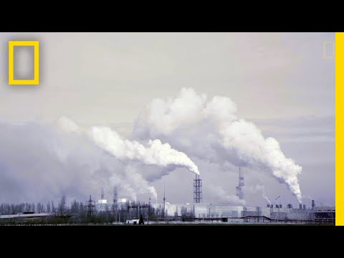
Video
National Geographic 2017, https://www.youtube.com/watch?v=G4H1N_yXBiA

Slide 7
Brainstorm Activity-
What are some causes of climate change?

Slide 8
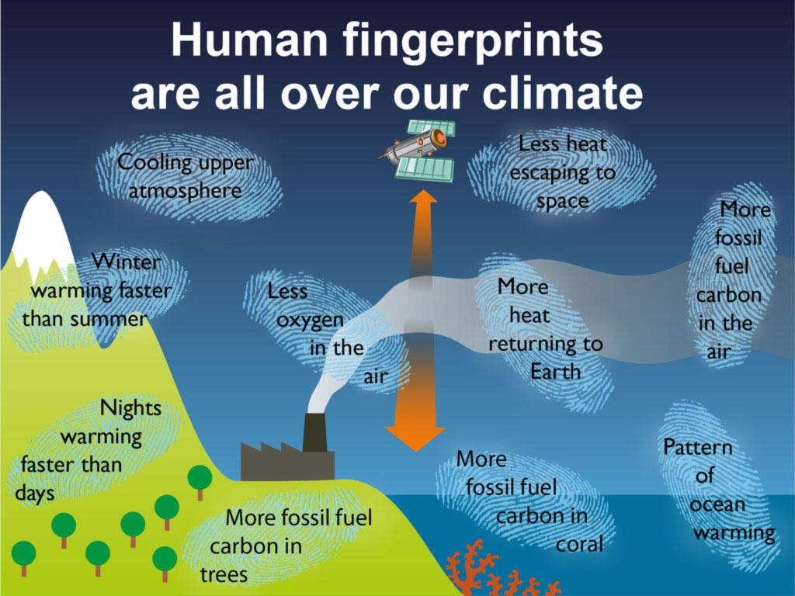
Causes of Climate Change
Global climate change is unequivocally caused by human activities
Fossil fuels
Deforestation
Increasing livestock farming
Fertilisers containing nitrogen
Fluorinated gases
Notes:
Speaker notes — define causes:
Burning coal, oil and gas produces carbon dioxide and nitrous oxide.
Cutting down forests (deforestation). Trees help to regulate the climate by absorbing CO₂ from the atmosphere. When they are cut down, that beneficial effect is lost and the carbon stored in the trees is released into the atmosphere, adding to the greenhouse effect.
Increasing livestock farming. Cows and sheep produce large amounts of methane when they digest their food.
Fertilisers containing nitrogen produce nitrous oxide emissions.
Fluorinated gases are emitted from equipment and products that use these gases. Such emissions have a very strong warming effect, up to 23 000 times greater than CO₂. (European Commission on Climate Action, n.d.)

Slide 9
Think, Pair, Share- What are some prevention measures for climate change?

Slide 10
Prevention Measures
Climate change is rooted in the unsustainable use of resources. Many small changes in everyday lives are needed in addition to large overarching measures
greenhouse gas emissions

Slide 11
What is a Carbon Footprint?
Carbon footprints estimate the total amount of greenhouse gases emitted during the production, processing and retailing of consumer goods. We all have Carbon footprints.

Slide 12
Carbon Footprint Worksheet
Please pull out worksheets & a pen
Notes:
Speaker notes:
A carbon footprint is the total amount of greenhouse gases (including carbon dioxide and methane) that are generated by our actions.

Slide 13
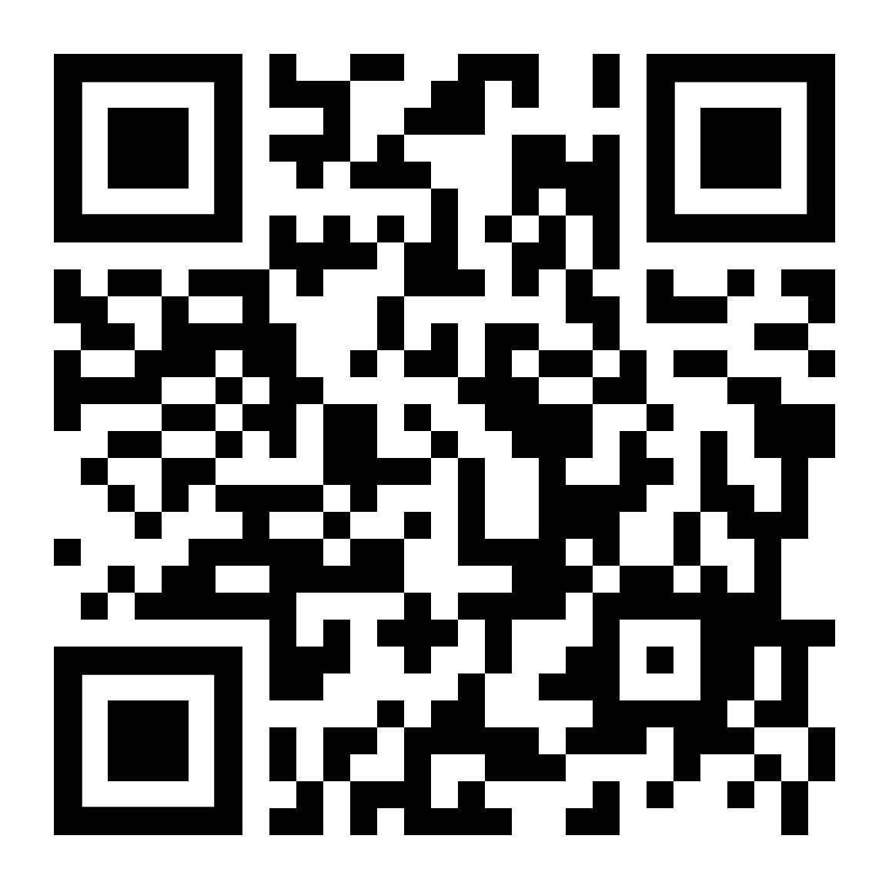
Evaluation
Please pull up the google form
https://forms.gle/Hpa2X31vssG8giiQ9

Slide 14
Sources
European Commission on Climate Action. (n.d.). Causes of climate change. Climate Action. Retrieved October 26, 2021, from https://ec.europa.eu/clima/climate-change/causes-climate-change_en.
NASA. (2021, October 12). Climate change evidence: How do we know? NASA. Retrieved October 26, 2021, from https://climate.nasa.gov/evidence/.
National Geographic 2017, https://www.youtube.com/watch?v=G4H1N_yXBiA
What kind of footprint? Carbon Footprint - Lesson. TeachEngineering.org. (2021, November 4). Retrieved November 9, 2021, from https://www.teachengineering.org/lessons/view/cub_footprint_lesson1.

