Slide 1
Undergraduate Research Opportunities

Slide 2
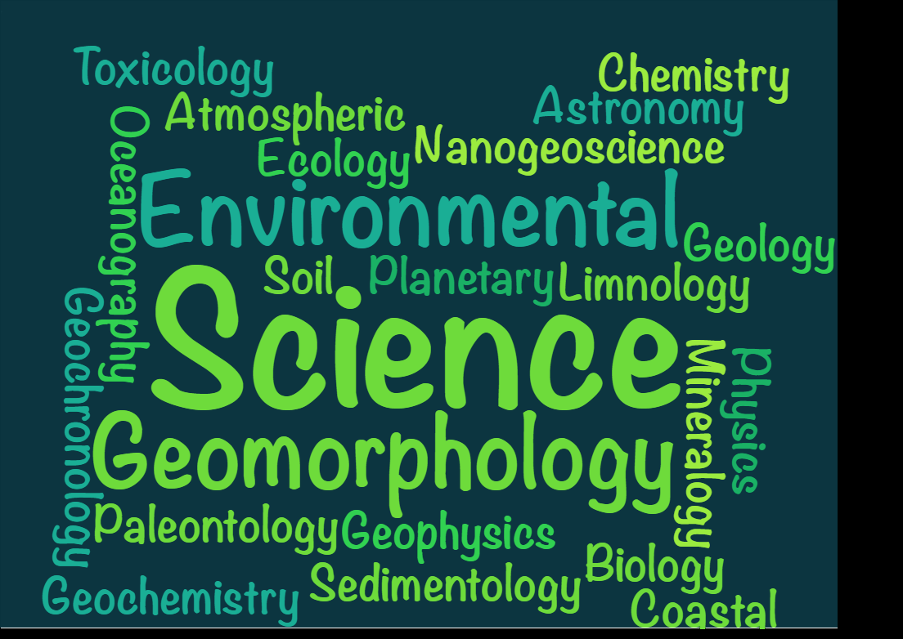
Why do research?
Because you are passionate about a subject and want to learn more!

Slide 3

Why do research?
Work experience and skill building
Can help you decide whether to go on to grad school
If you want to go directly to a Ph.D.
But you also have to be curious about your topic!

Slide 4
Research options for undergrads
URP
  “Undergraduate Research Program”
  Fairly selective
  Requires a 3.0 GPA
    Counts repeat classes
  Can only do once in the summer and twice in academic year
  Can use for field camp, so choose summer carefully
  Summer/Fall 2018
    Application: March 16-23
  Rose McGinnis CST email
UVP New
  “Undergraduate Volunteer Program”
  Volunteer for an EES grad student
  Day/s to week/s, but varies by task
  Great way to get started/get a feel for research
  Featured later in presentation
Independent Study/Directed Reading
  Work with a faculty member you know
  1-3 credits
Internship
  EES Connection
  Rose McGinnis CST email
With all of these options, you must talk with a faculty member/grad student first!

Slide 5

CST opportunities
CHECK EMAIL
Geo listserv
Undergraduate Research Session
  Look for email from Rose McGinnis
  Email: rose.mcginnis@temple.edu
EES Connection
  As an EES student, would you want to know when it is updated or check it yourself?

Slide 6
Undergraduate Volunteer Program (UVP)
Free research experience for you
Free research help for grad student
You’ll be helping or shadowing a graduate student with a task/s in the lab or in the field
Can add experience to your résumé/CV
Can give you an idea of research tasks
Contact graduate student via email
You and grad student will work out a schedule
For geology and environmental science majors
If you’re an SGE member
  Fulfills your continuing education expectation

Slide 7
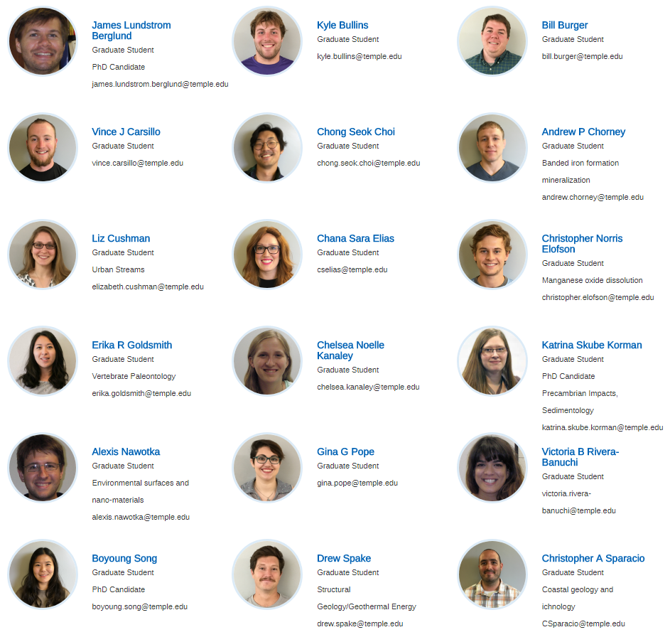
Temple EES research areas:
grad students
Check the EES web page for current list of grad students

Slide 8
How to email faculty
(or a grad student)
Make sure your name is on the email
  Not just tug12345@temple.edu
Do not write emails as if they are text messages
Structure your email properly with salutation, main body, closing, and signature
“Hey XXX,” is not appropriate
Example:
Dear Professor or Dr. XXXX,
Main body
Sincerely,
YYY

Slide 9

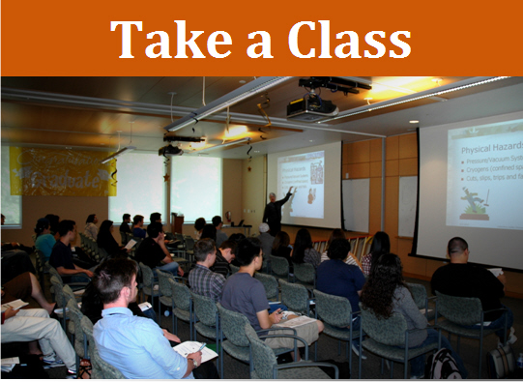
How to develop a relationship with faculty
Take a class
Set up an outside meeting to discuss mutual interests

Slide 10
How to ask for a letter of recommendation
Send a CV
Offer to chat with the faculty
If meeting in person is difficult, say a few things about goals in the email
Just having taken a class does not usually give faculty a lot of information to write a GOOD LETTER unless you did exceptionally well in the class
Remember that faculty can write any letter, but the letter of recommendation needs to be GOOD
Give AT LEAST TWO WEEKS NOTICE to write a letter for you
Good resources on how to request a letter of recommendation: READ THEM WELL!
  https://csumb.edu/trio/getting-recommendations
  http://gradschool.cornell.edu/inclusion/recruitment/prospective-students/tips-requesting-letters-recommendation

Slide 11
Ways to present your undergraduate research
URP Symposium
  For URP students
  Held in the SERC
TURF-CReWS
  “Temple University Undergraduate Research Forum - Creative Works Symposium”
  All Temple departments and colleges
  Must submit a proposal by Feb. 5
  Held April 12 @ Student Center
SGE Sessions/Meetings (like this one)
  Contact an SGE officer
Conferences
  GSA, Northeast GSA, AGU, AAPG, SEPM, LPSC, etc.
  Undergrads usually present a poster
  Funding: CARAS (university), faculty

Slide 12
Current and recent undergraduate research in EES
Undergraduate Presenters!
John Mangan
Marley Chertok
Sophie Silver & Carey Johnston
Kelly Devlin
Katie Hayes

Slide 13

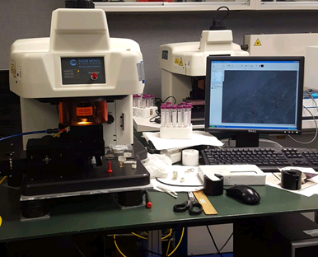
John Mangan
Pachyrhinosaurus rib bone
Rock Lab
Paleobond
Epoxy mold
Thin Section
Analysis
University of Maryland Laser Ablation analysis
Taphonomic and faunal analysis of vertebrate microfossils
Sediment and fossils sorted by size from prehistoric ants
Microscope Lab

Slide 14
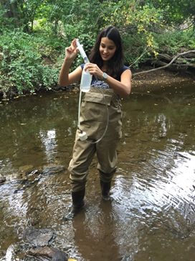
Marley Chertok
The Impact of Tributaries and Wastewater Treatment Plants on Water Quality in an Urban Stream
Learned how to collect and analyze real (messy) data
  Field sampling
Taught lab skills and etiquette
  Nutrient filtering
  IC
  ICP-OES
Opportunity to present my research
Skills I learned landed me an internship

Slide 15
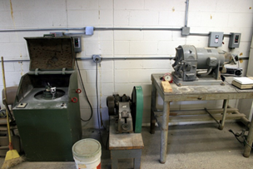
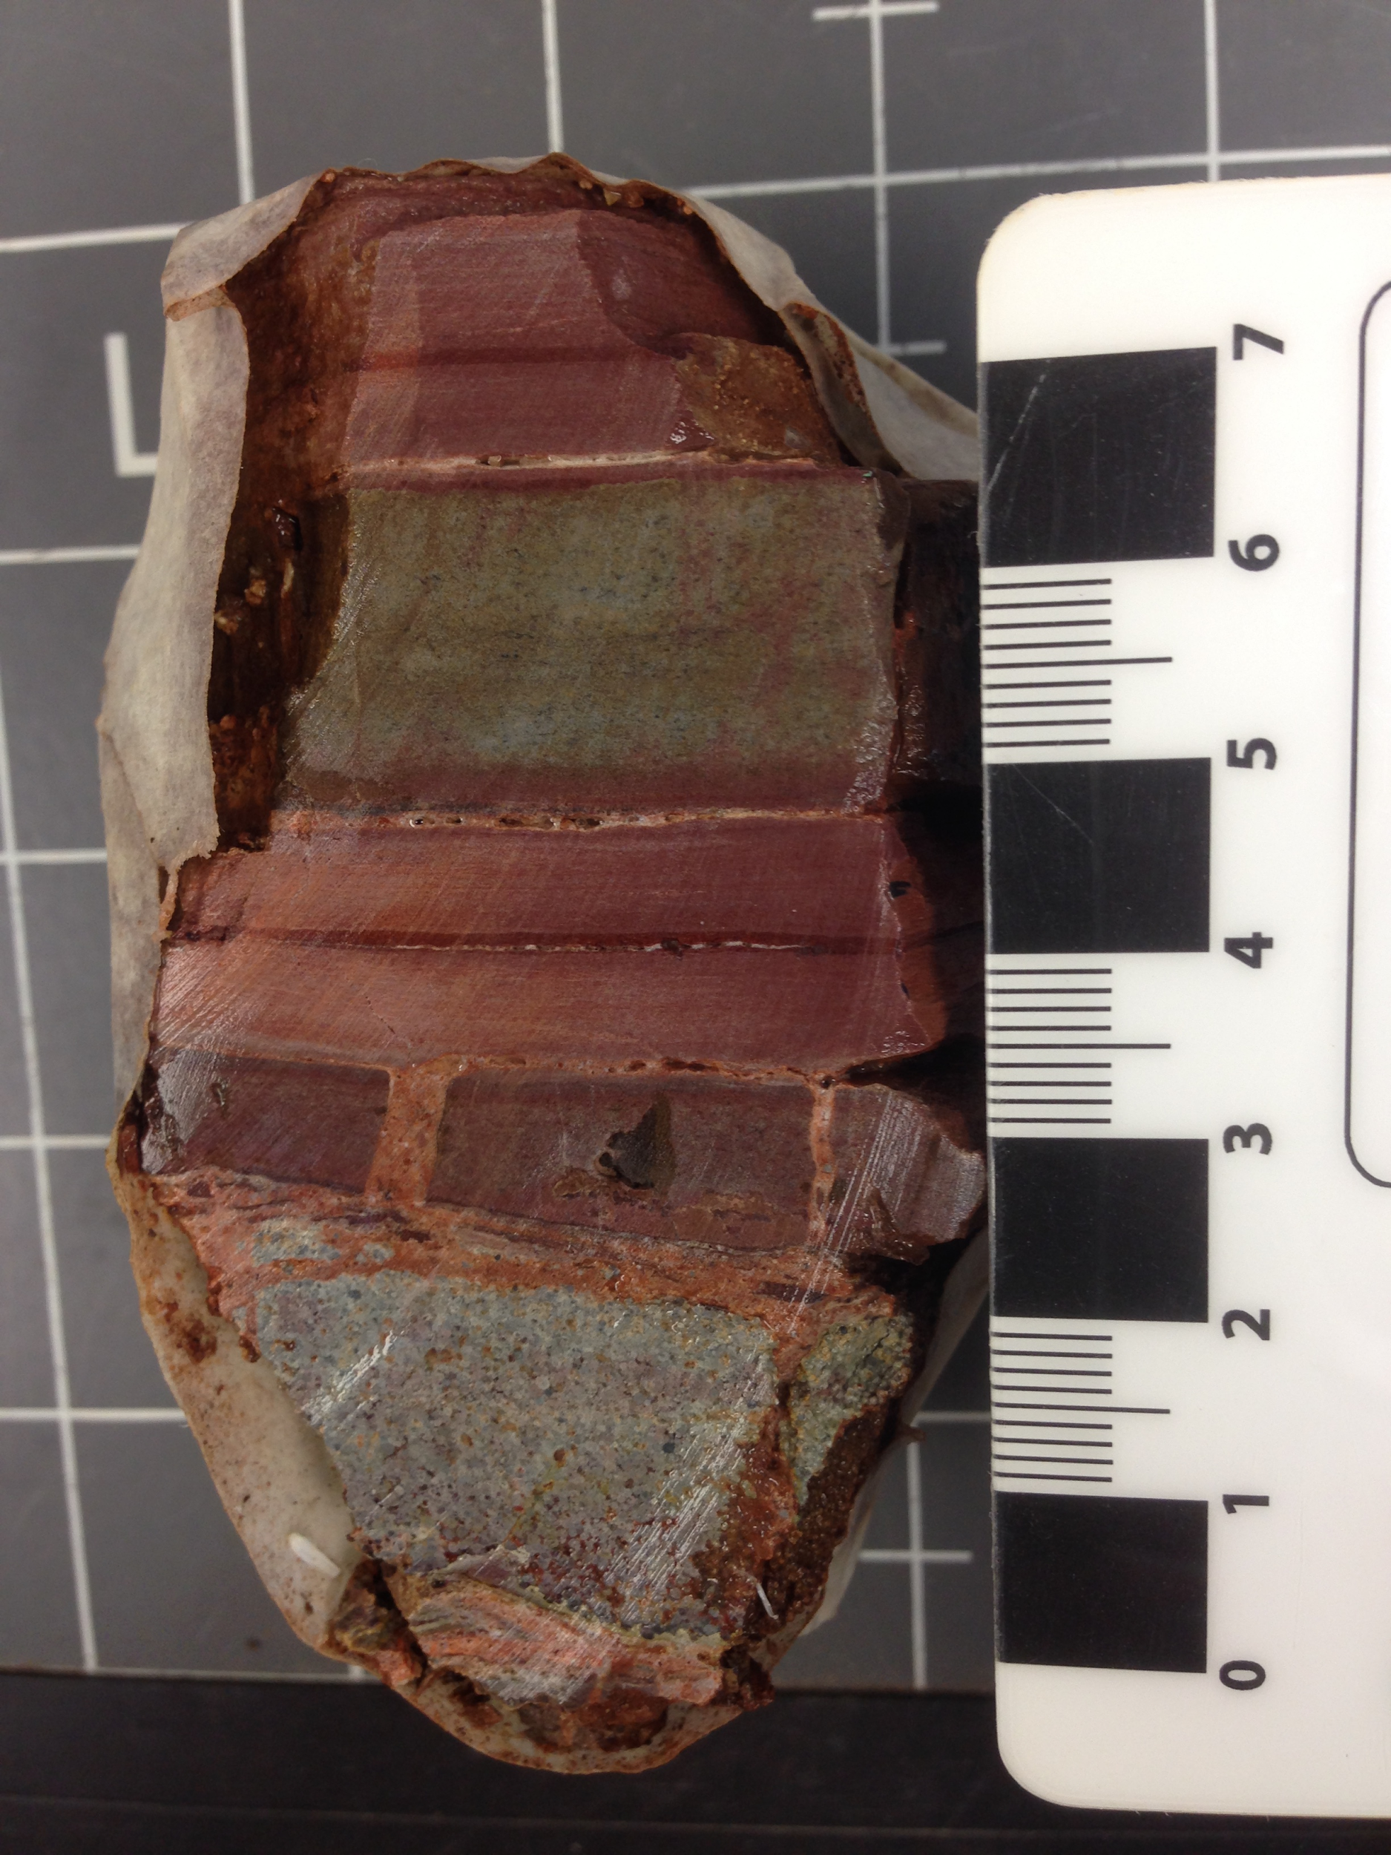
Sophie Silver & Carey Johnston
Impact Seds Project
Used multiple machines
  Disc grinder
  Jaw crusher
  Rock saw
Acid bath
Magnetic separation
Methods section
Epoxy
Analogy Project
Deciding on keywords
Finding analogies in textbooks
Spreadsheet
Weekly meetings

Slide 16
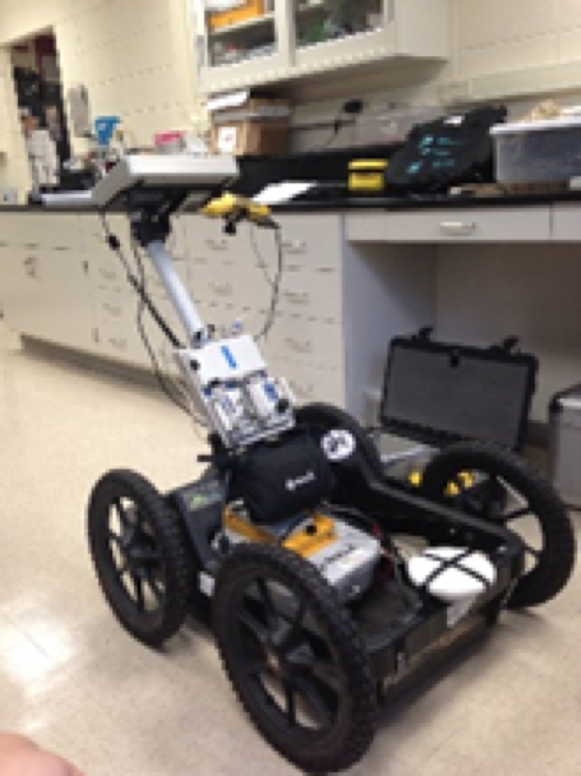
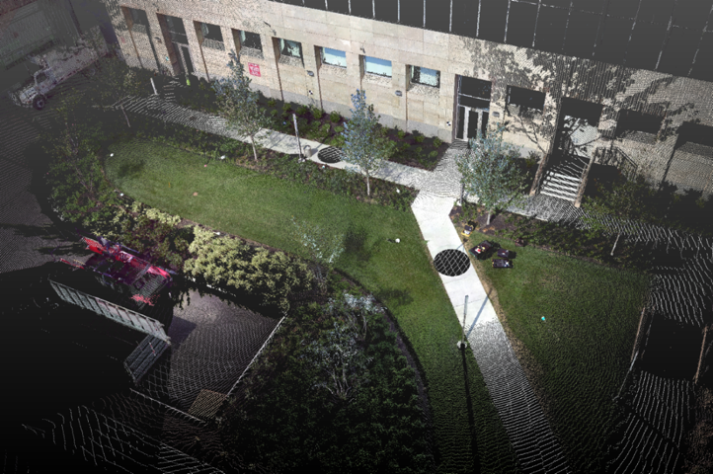
Kelly Devlin
Use and limitations of ground penetrating radar in an urban stormwater basin
Created artificial rain event using sprinklers on Temple’s campus
Collected and analyzed repeat GPR surveys
Tracked soil moisture via buried sensors
Presented at URP Symposium and GSA in Baltimore
This experience taught me Matlab and helped me get into an REU the next year

Slide 17
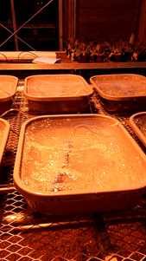
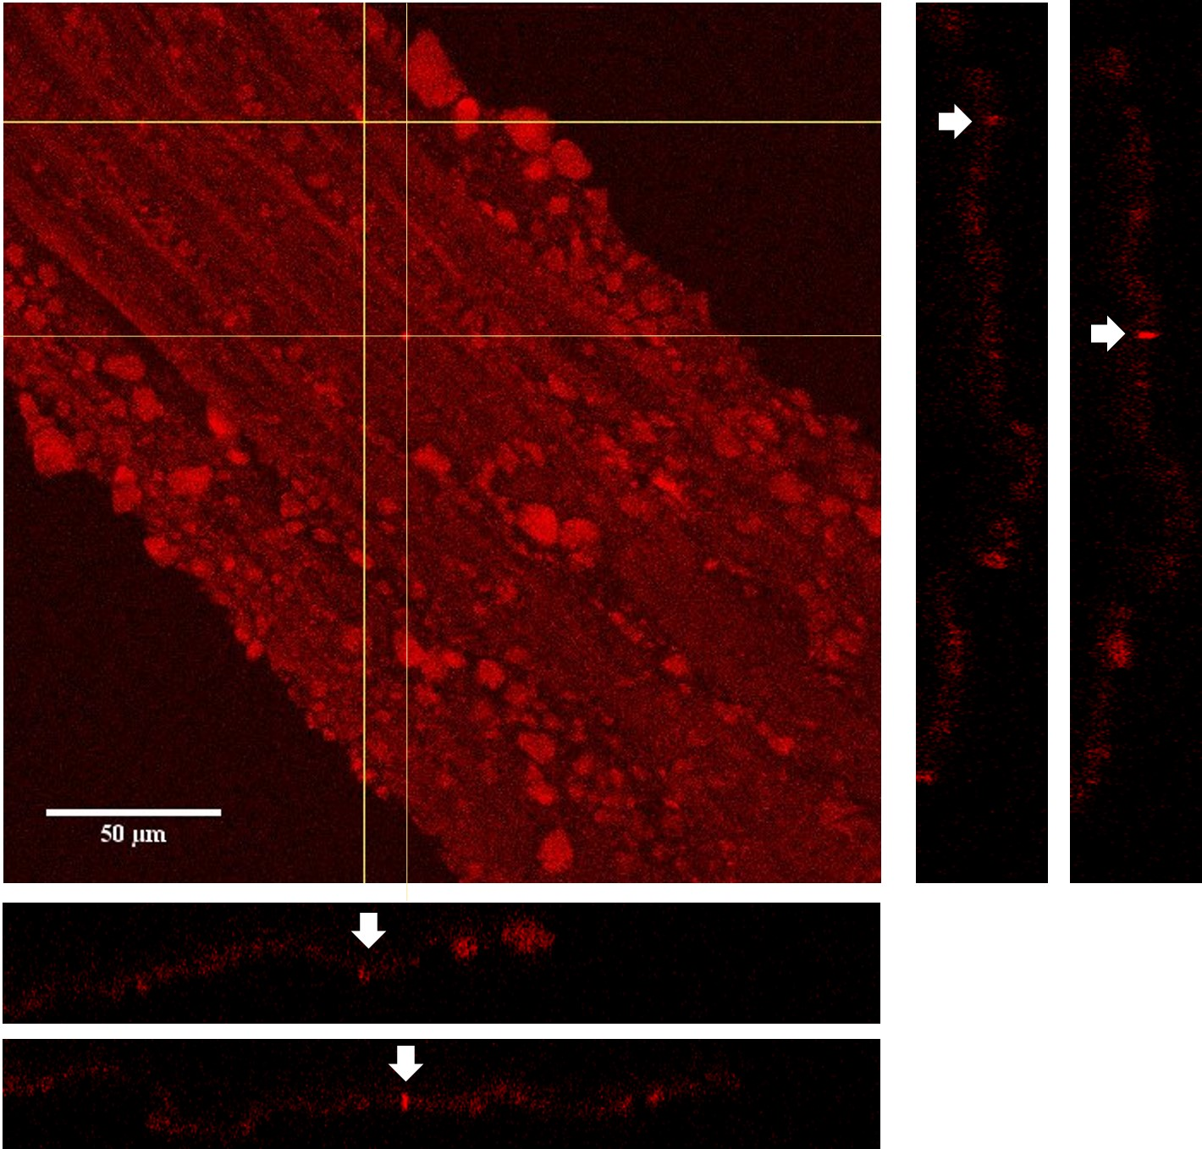
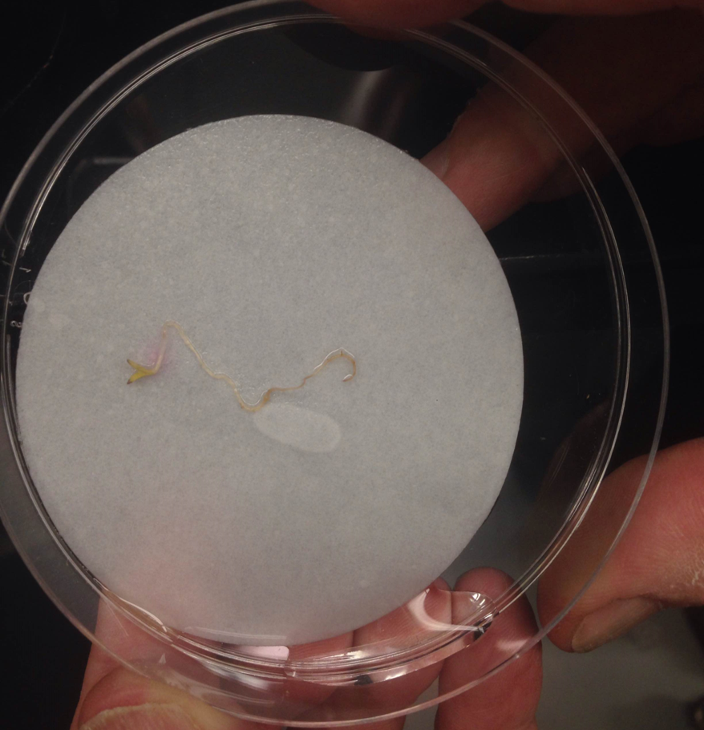
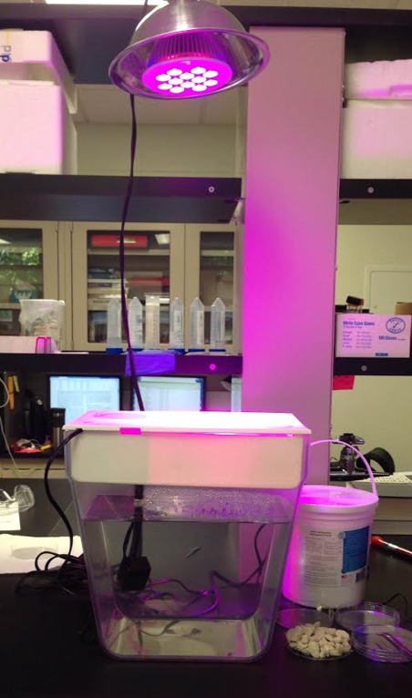
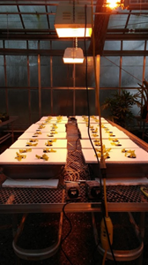
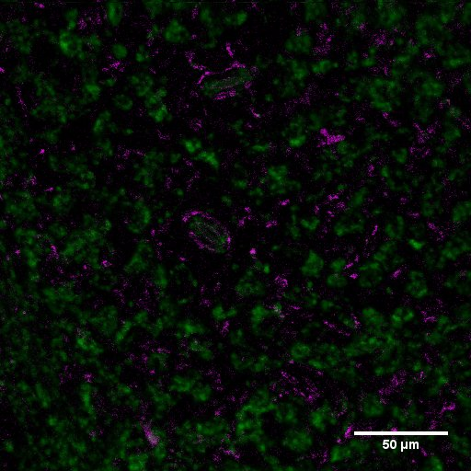
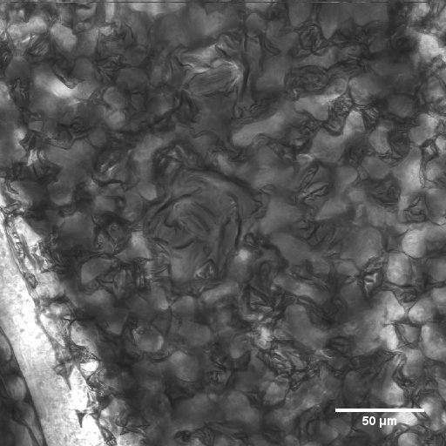
Katie Hayes
Uptake, Distribution, and Effects of Nano Alumina in Terrestrial Plants at the Cellular and Macro-scale Levels.
Goals:
Can Aluminum Oxide Nanoparticles move into a plant system; Roots, Stem, and Leaf
Is Laser Scanning Confocal Microscopy a viable method of indicating particle presence
Imaging Equipment
Laser Scanning Confocal Microscope
Other Methods
SEM
Chemical Analysis
Overall:
Collaboration
Skills - Lab and Field
Independence
Scientific writing and reading
Growing Systems

