Slide 1
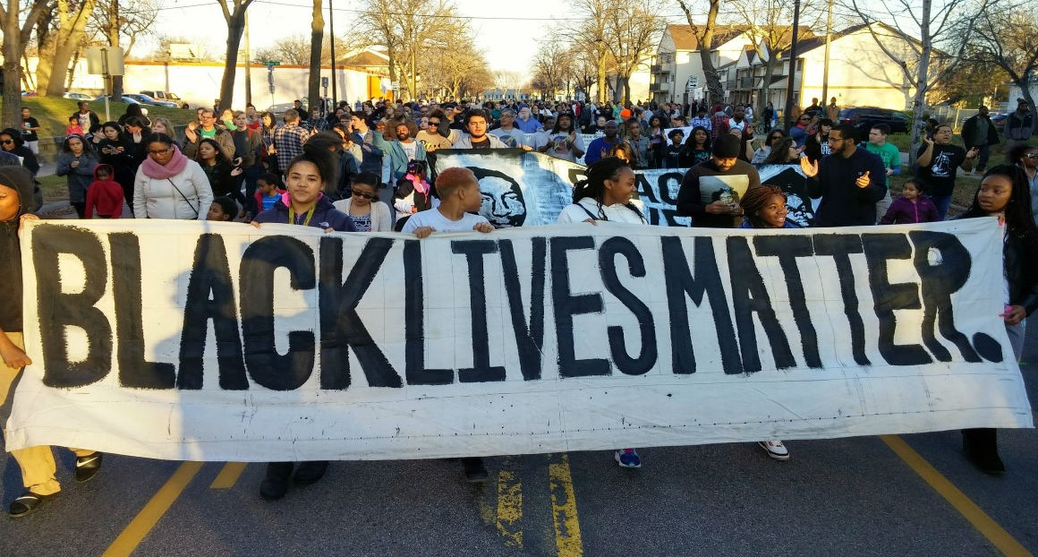
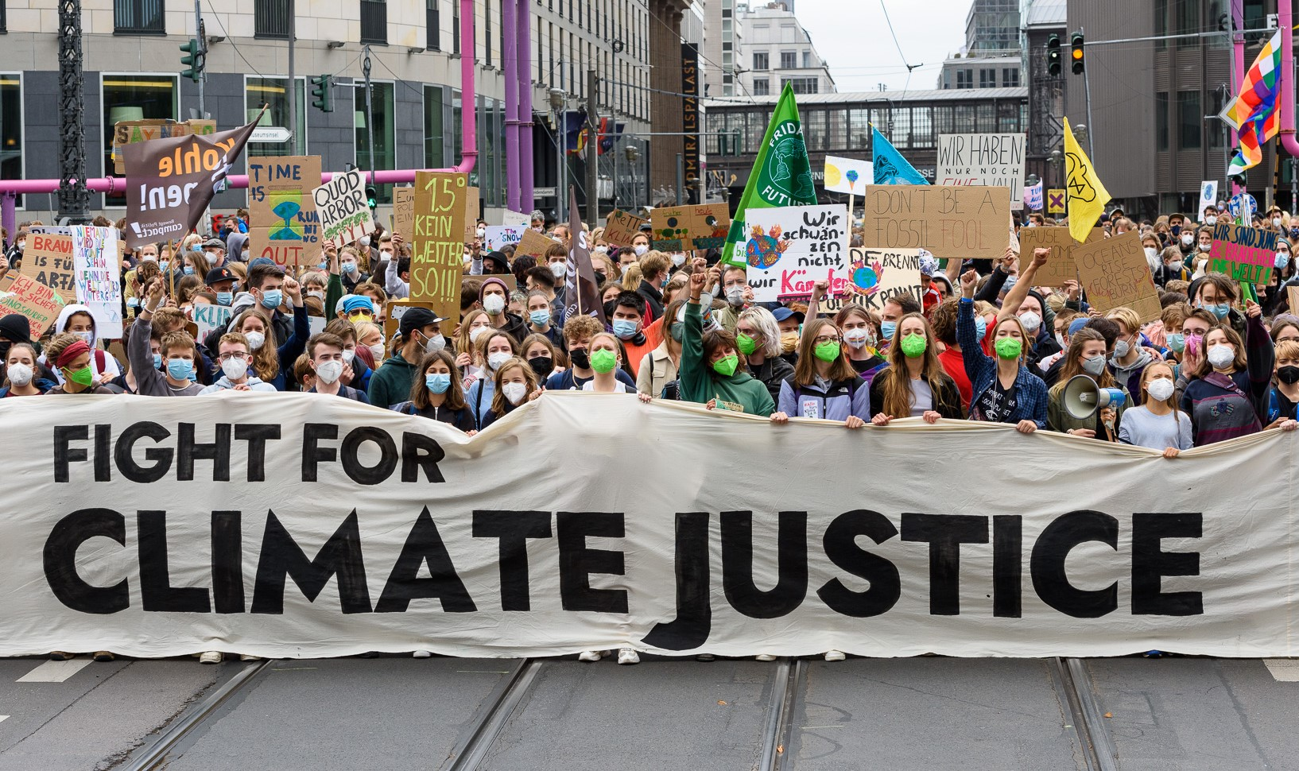
Teaching Civil Disobedience: Pedagogy of Resistance Jason Del Gandio, Ph.D. Klein College of Media and Communication Dept. of Communication & Social Influence
Definition & Examples
CD: Purposefully disobeying the laws, rules, or collective assumptions of society to bring attention to and ultimately end an injustice.
Sit-ins, die-ins, labor strikes, hunger strikes, tax strikes, boycotts, school walkouts, building occupations, digital protests, street performances, etc.
How to Design Actions
Bodies
Location
Context
Choreographed Action
“Props and Costumes”
Signifiers
Risk and Disruption Levels
Goal(s)
Dissemination (media/social media)
Why Teach CD
CD is a key component to social movement activity and social progress
11.5% increase in mass protests 2010-2019 across all regions of the world
Helps students understand logics of activism and gives them a sense of empowerment
Learning Objectives
Understand the logic, practice, and execution of CD
Understand CD as a form of political communication/rhetoric
Understand resistance as an ever-present possibility
Understand how to question and challenge socialization and collective assumptions
Understand how to manifest alternative epistemologies
Key Figures Lineage
Henry David Thoreau
Leo Tolstoy
Mahatma Gandhi
Dr. Martin Luther King, Jr.
Contemporary
Gene Sharp
Howard Zinn
Andrew Body & Dave Oswald Mitchell
Mark Engler & Paul Engler
Pedagogical Advice
Assignments
Can be traditional (exams and research papers)
Or more creative (artistic, poetic, theatrical)
Incorporate non-political examples
Music, art, theater, film, personal relations, work contexts, linguistic choices
Keeps students interested, creates better discussion, expands their understanding of political resistance
Diversify voices, examples, readings, traditions
Women of color, LGBTQ+, disability activists, other countries, etc.
Class can be emotionally laborious (serious social issues are raised)
References/Sources:
See handout

