Slide 1
Beta Alpha Psi and The Fox Accounting Association

Slide 2
Icebreaker

Slide 3
What is Beta Alpha Psi?
An international honorary organization for Financial Information students and professionals
Students pursuing studies in Finance, Accounting, and/or MIS
Objectives
Exposure to Area Firms and Corporations
Career Navigation and Information
Community Service
Leadership Experience
Programs
Associate Program (joint with FAA)
Candidate Program
Mentorship Program
VITA

Slide 4
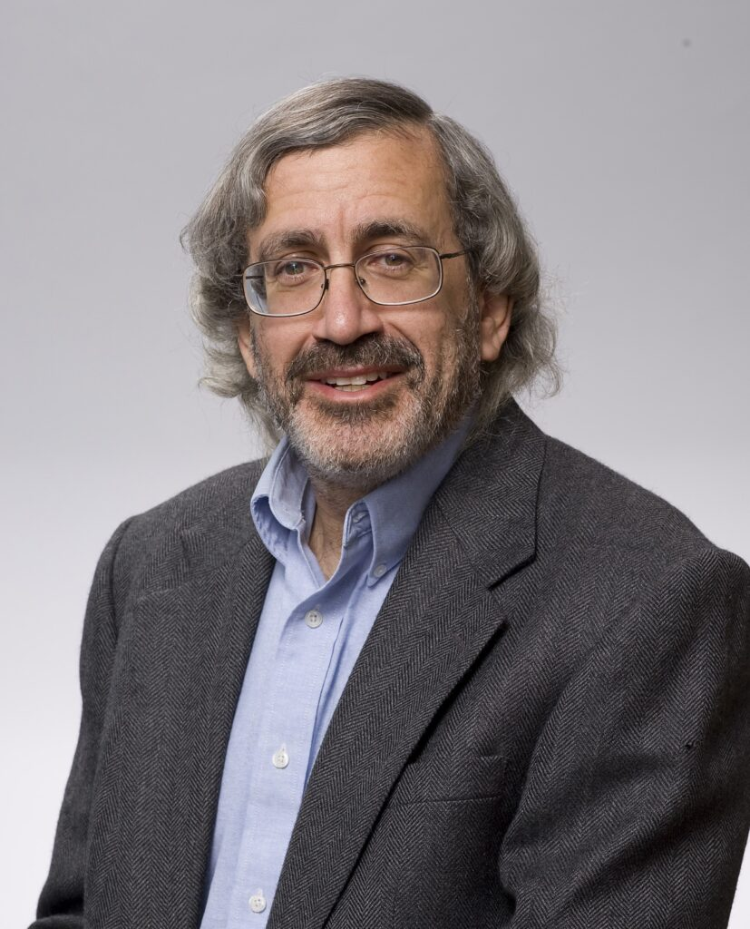
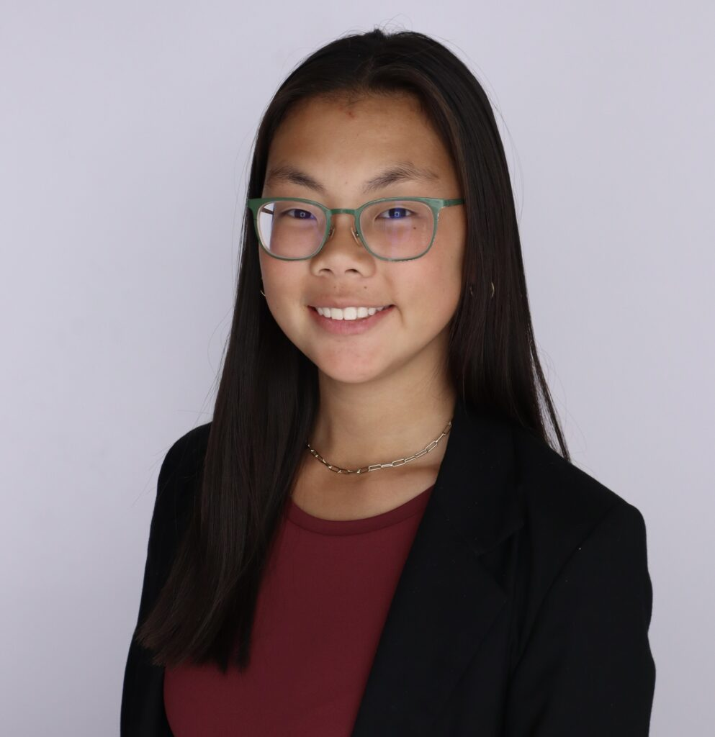
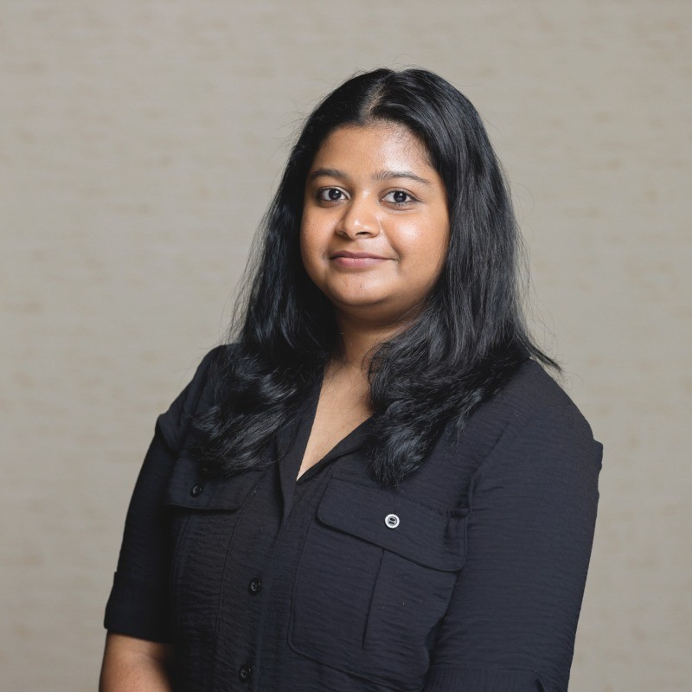
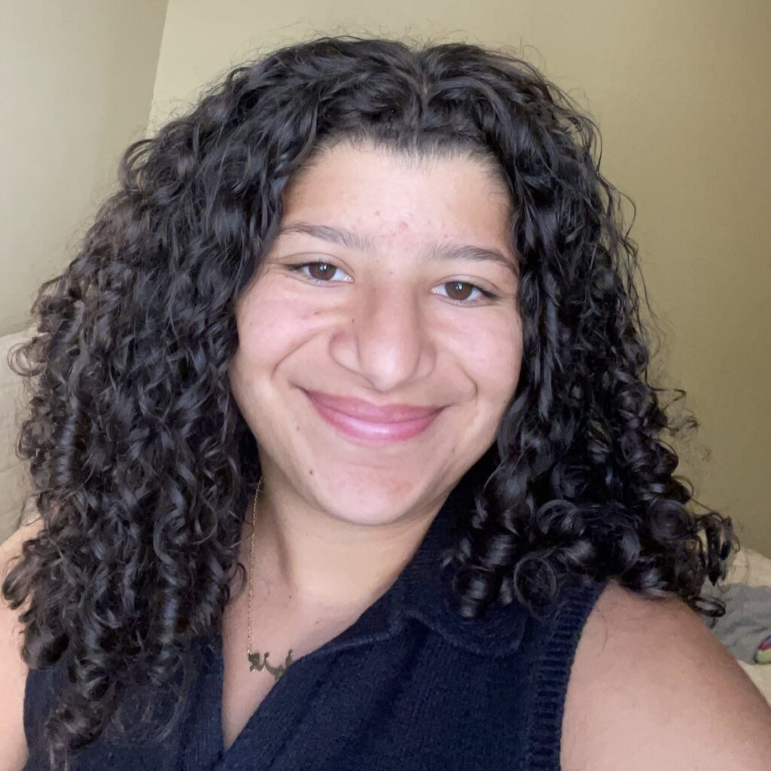
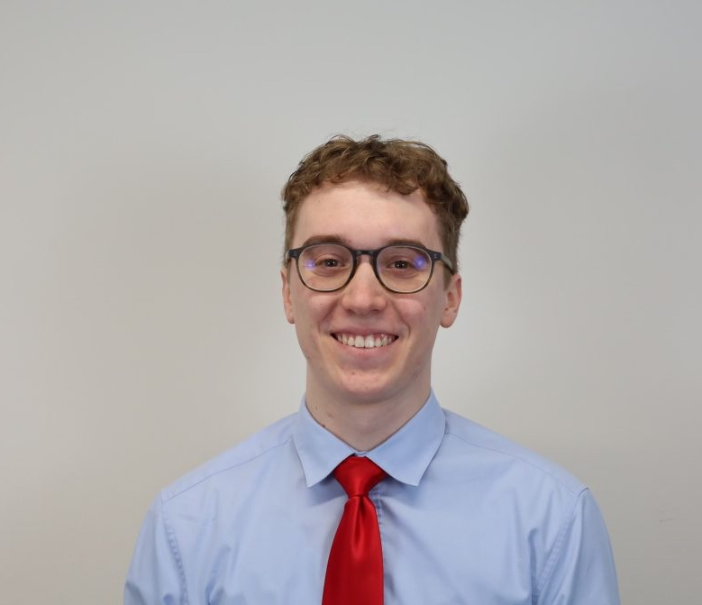
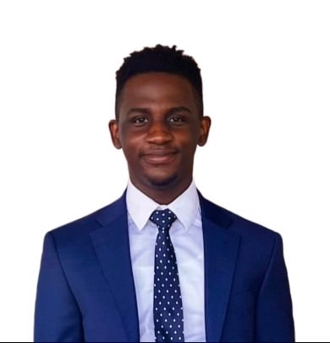
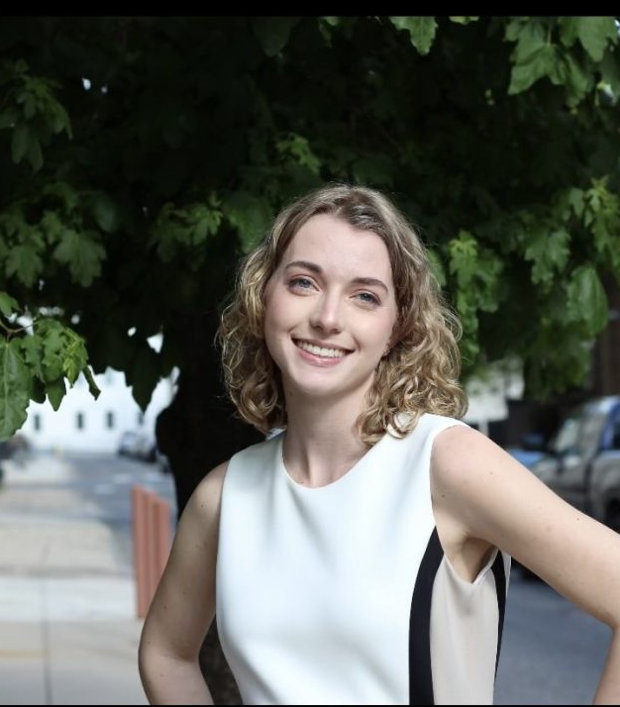
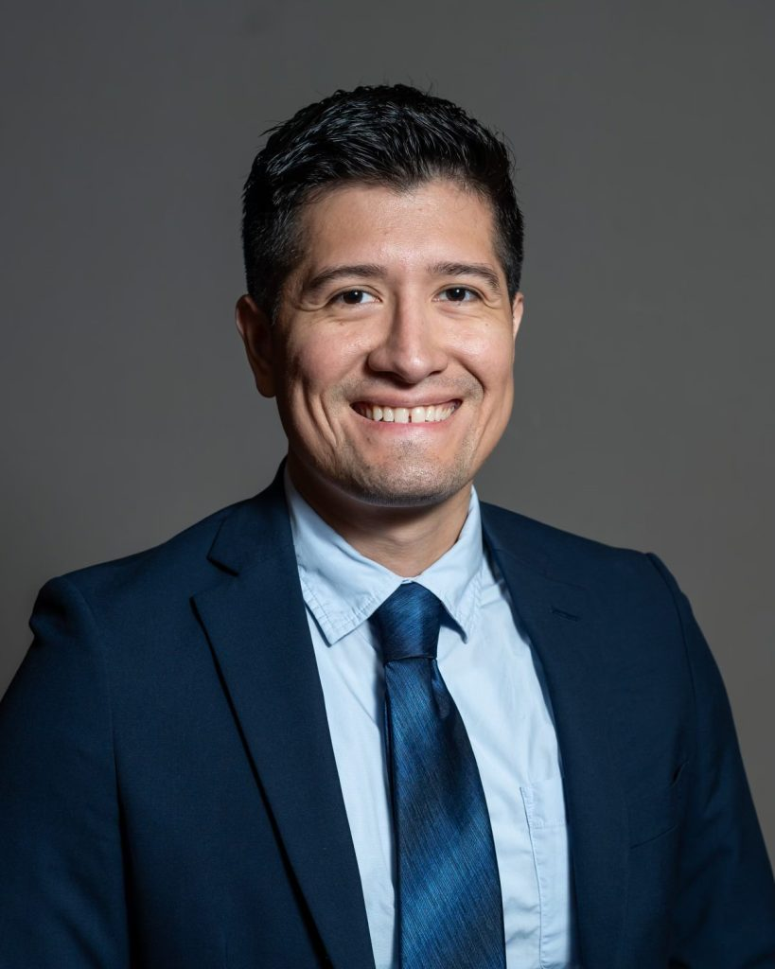
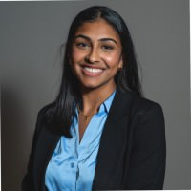
BAP Board Introductions
Dr. Steven Balsam
Faculty Advisor
Maya Manders
President
Senior Finance and Accounting major
Nayana Santhosh
Vice President
Senior MIS and Accounting major
Jenn Farhat
Treasurer
Senior Accounting major
Chris Gasiewski
Director of Communications
Senior Finance and Accounting major
Toni Olofinyolemi
Director of Member Reporting
Senior Accounting major
Erika Anderson
Director of Community Service
Senior Accounting major
Josue Moyano
Director of Recruitment
Senior Accounting major
Tina Thankachan
Director of Mentorship
Senior Accounting major

Slide 5
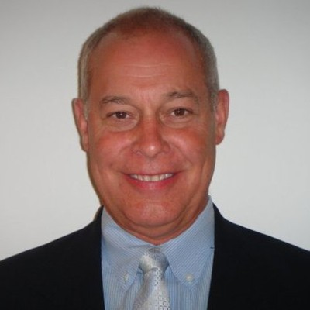
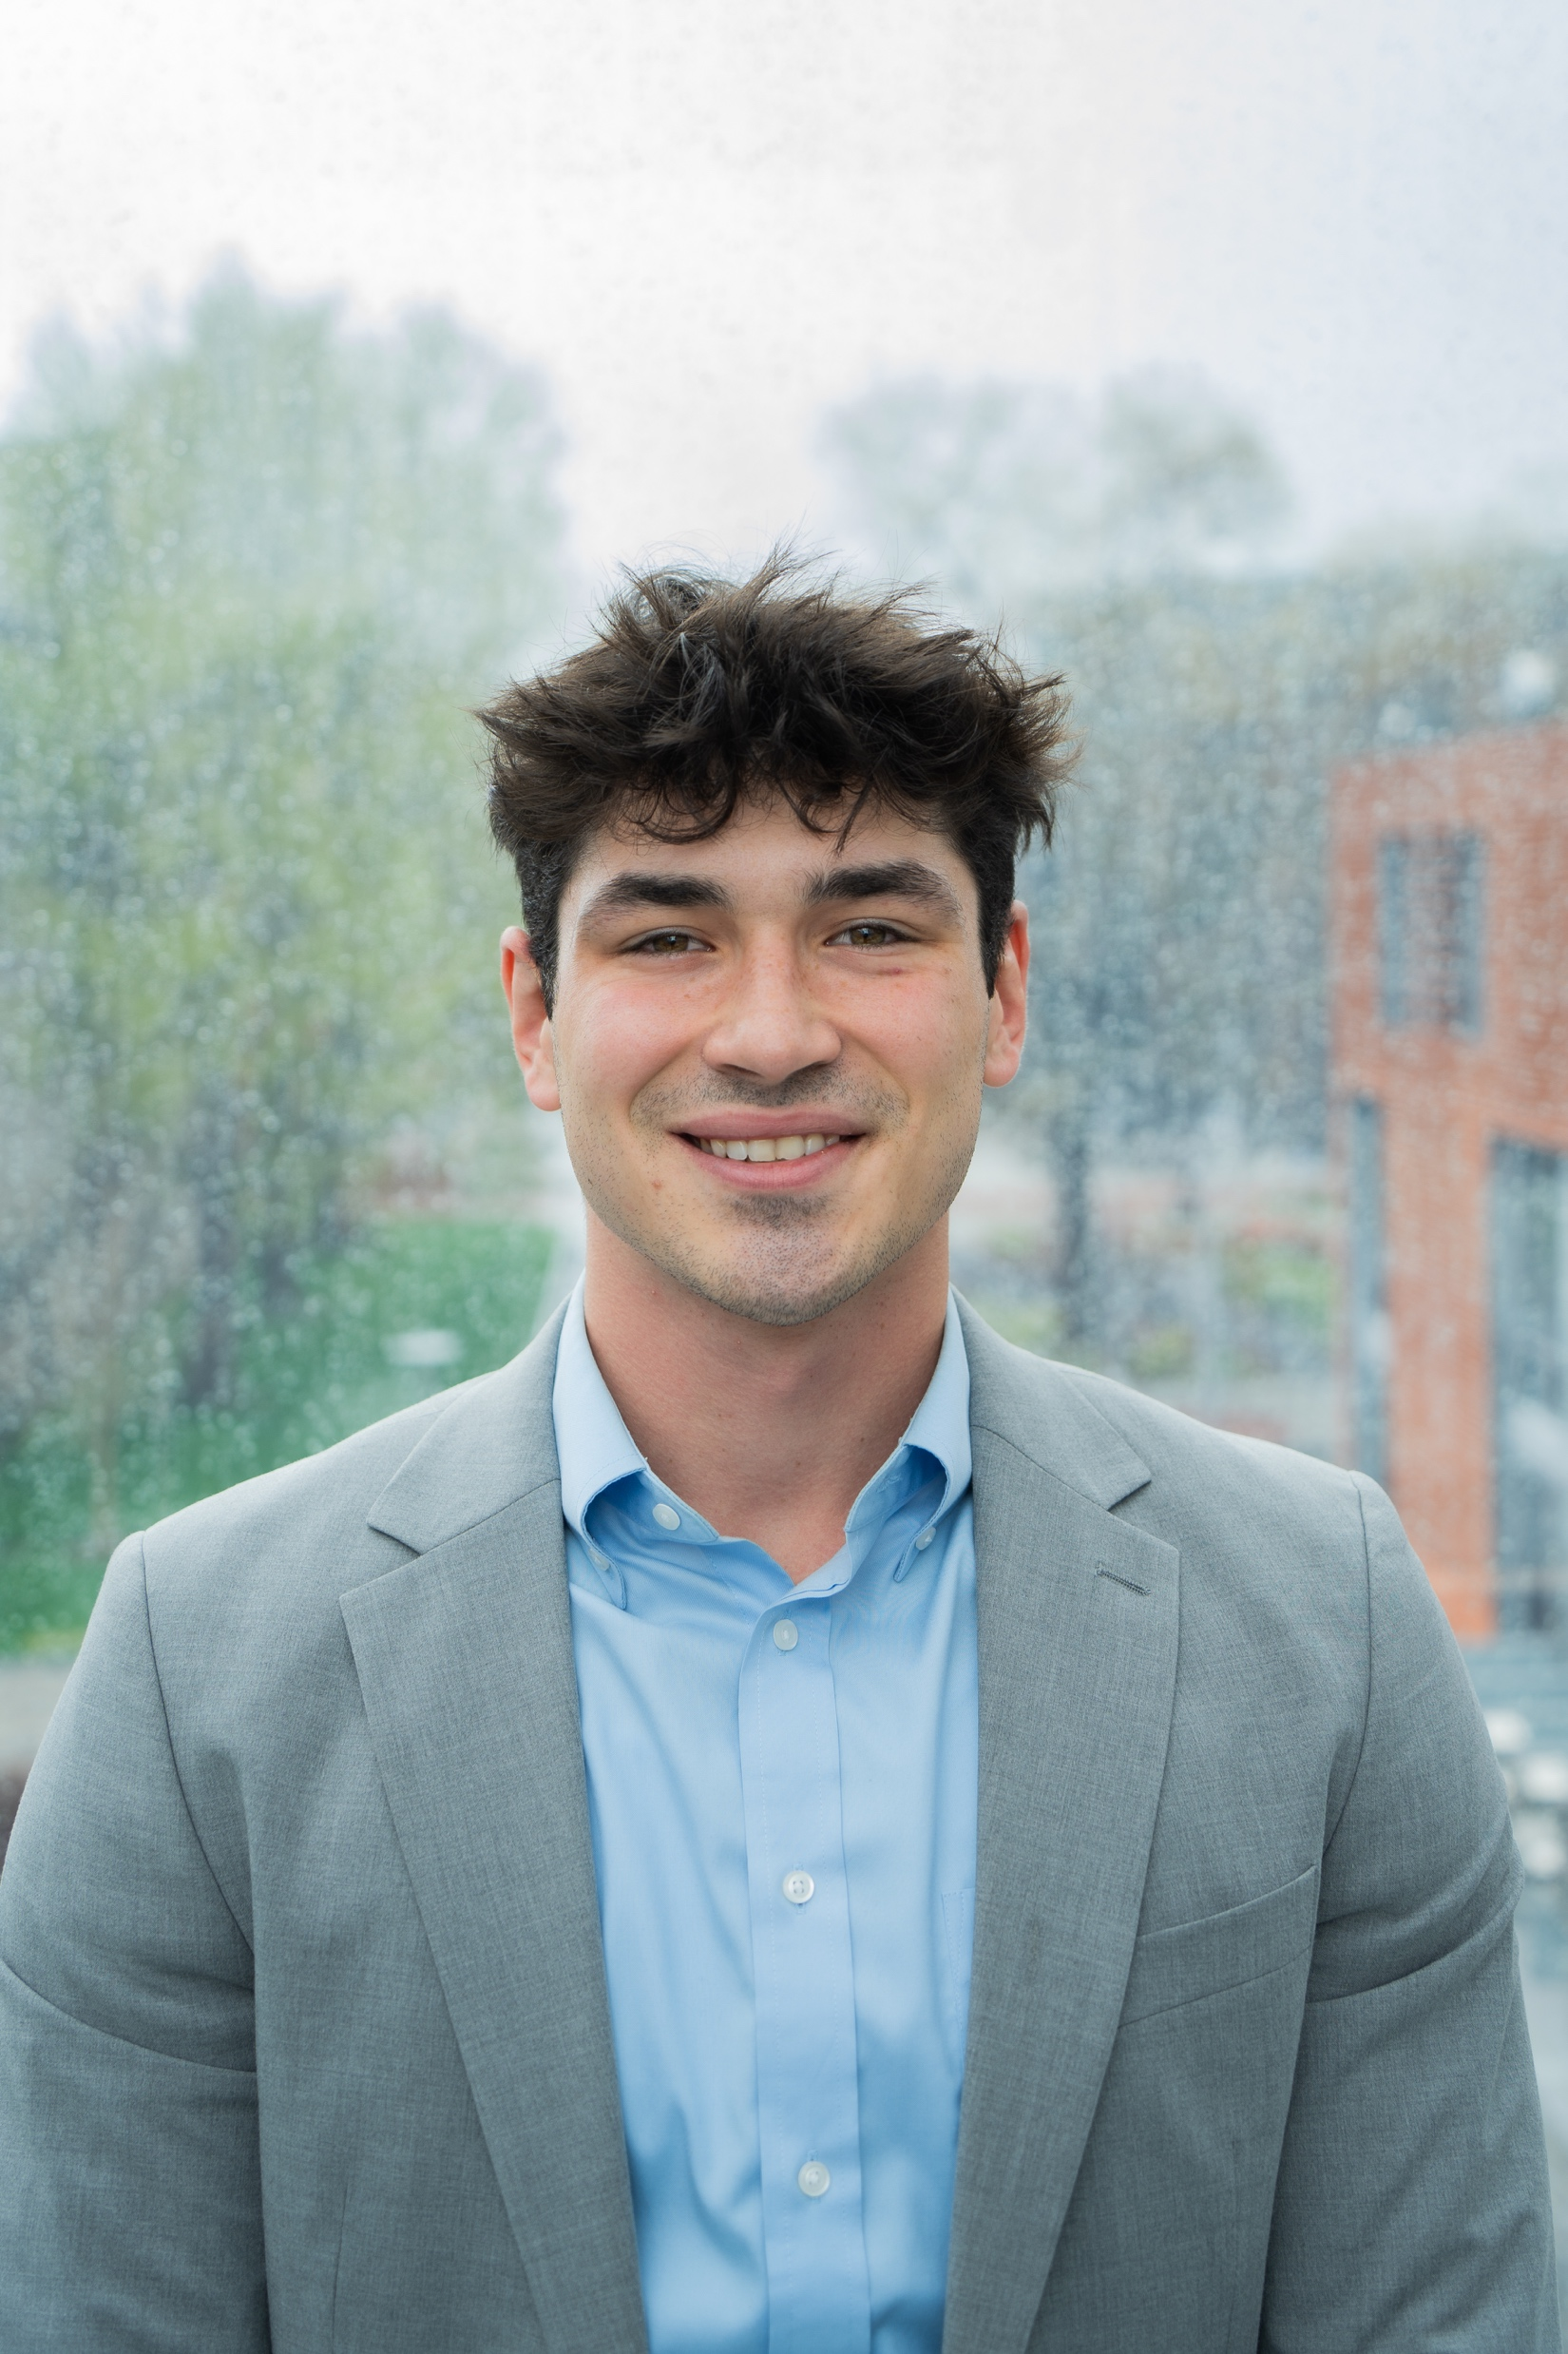
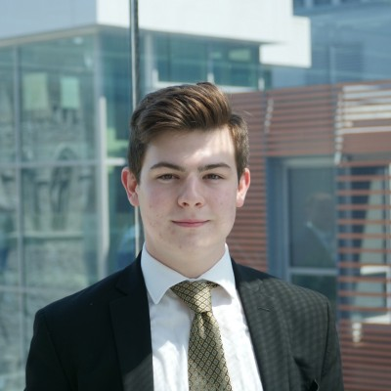
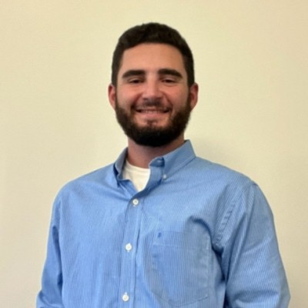
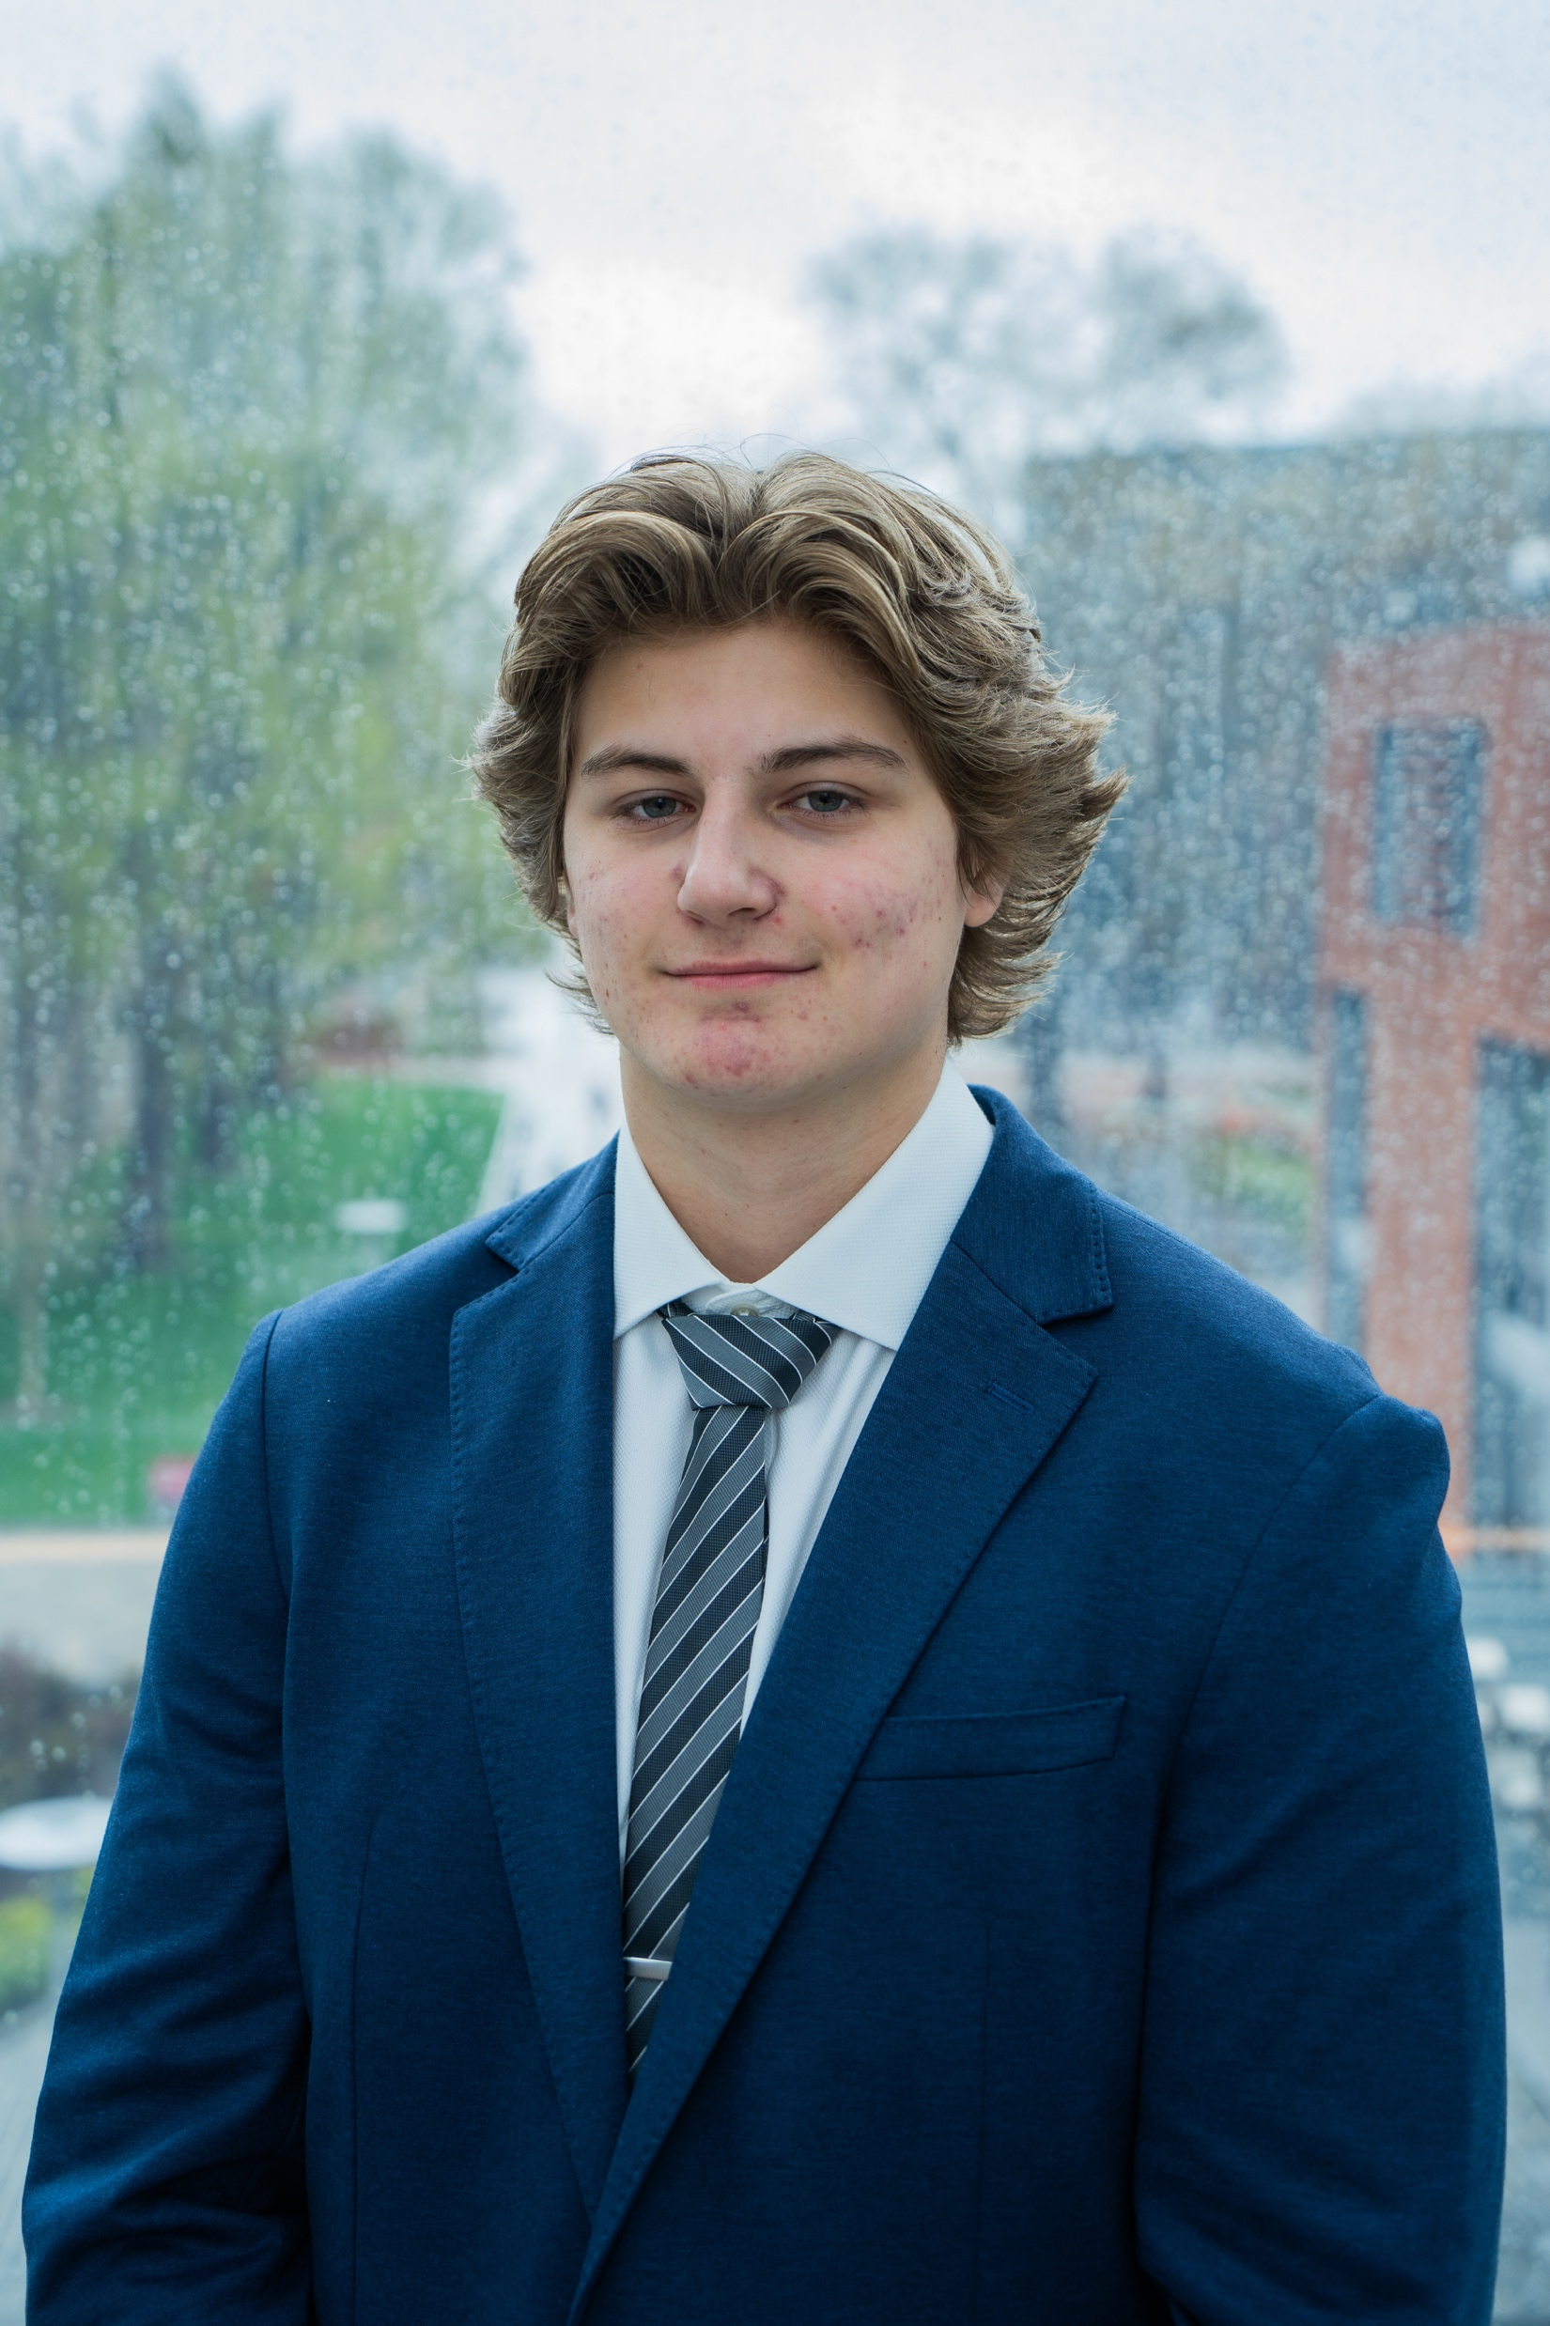
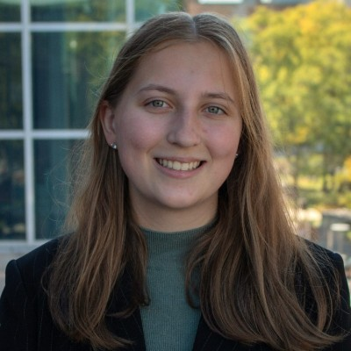
FAA Board Introductions
Professor Dave Jones
Faculty Advisor
Jack Schweitzer
President
Senior Accounting major
Anthony Stevenson
Vice President
Senior Accounting major
Troy Hurwitz
Treasurer
Senior Accounting major
Andrew Musser
Director of Member Reporting/Secretary
Sophomore Accounting major
Natalia Redziniak
Director of Marketing
Junior Accounting major

Slide 6
Candidacy Requirements
Declared a major in Accounting, Finance, or MIS
Achieve a cumulative and major GPA of 3.0+
Therefore, Enrolled in or Completed a Major Course
Accounting majors: ACCT 3511 B or higher
Finance majors: FIN 3101 B or higher
MIS majors: MIS 2502 B or higher
Attend 10 Hours of Professional Events
Attend 6 Hours of Service Events
Attend 2 Signature Events

Slide 7
Associate vs Candidate Member
Associate Member
Candidate Member
Become a member of BAP and FAA
$35 dues
No strict requirements
Become a national member
$75 national dues
Meet requirements on next slide
Access to alumni network
E-Board opportunities
Initiation every semester!
Benefits of both
Discounted tickets for socials
Easy access to professional development and career navigation opportunities

Slide 8
Weekly Meetings
Time: 12pm – 12:50pm
Location (unless otherwise noted):
Monday meetings (joint w/ all SPOs): Alter LL34
Wednesdays: Speakman 114
Fridays: 1810 room 310
Business casual for meetings with speakers
Food provided
Come with Questions!

Slide 9
Firms Coming in + Fun Events
Office Tours
Zoo Social
Campus Clean up
Evening with Recruiters
Walk 2 End Alzheimer’s
Flyers Game
BAP Annual Meeting
… and many more!

Slide 10
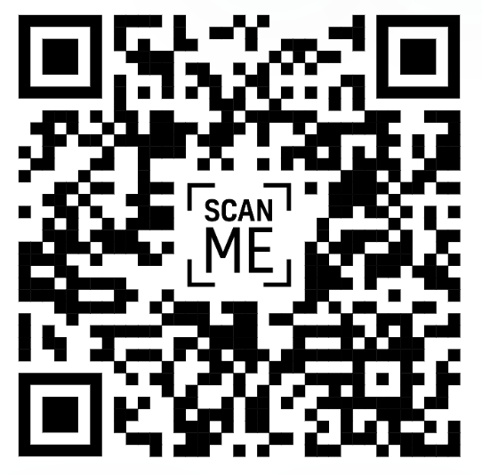
Upcoming Schedule: September
Zoo Social Interest Form
Date: September 28th
Time: 12pm (subject to change)
Here's the form if the QR doesn't work

Slide 11
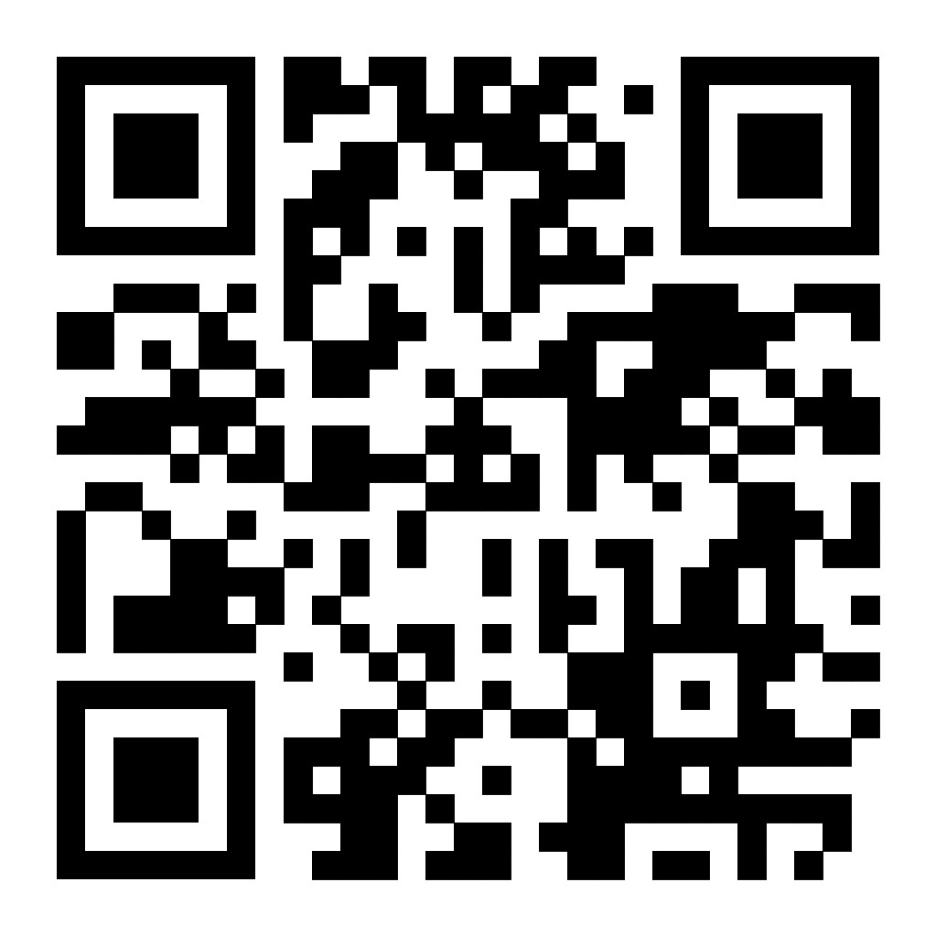
Mentorship Program
Sign-up Using QR Code
Mentees
Freshman, Sophomores, Transfer Students
Learn from Upperclassmen about anything you want!
Weekly Meetings (only an hour at max)
Mentors
Junior and Senior Members
Help younger members grow and develop
Give back to Beta
Resume Builder
Sign-up Link:
If the QR doesn’t work, please reach out to Tina Thankachan at tina.thankachan@temple.edu

Slide 12
Dues
Joint Associate member & FAA member: $35
Candidate member: $75 (national fee) **
** If you do not complete the candidacy process successfully in ONE YEAR, you will have to pay this fee again.
** Dues are nonrefundable
BAP: Jennifer-Farhat12
Joint: FAA2023-2024

Slide 13
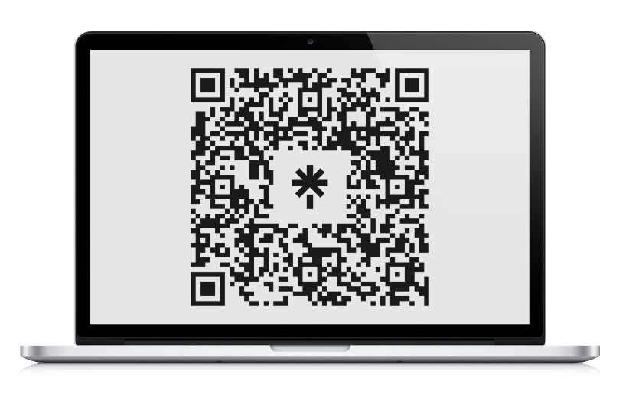
Beta Alpha Psi
Maya Manders | President
Maya.manders@temple.edu
Nayana Santhosh | Vice President
Nayana.santhosh@temple.edu
Jennifer Farhat | Treasurer
Jennifer.farhat@temple.edu
Fox Accounting Association
Jack Schweitzer | President
Jackson.schweitzer@temple.edu
Anthony Stevenson | Vice President
anthony.stevenson0002@temple.edu
Troy Hurwitz | Treasurer
thurwitz@temple.edu
LinkTree QR Code

Slide 14
Thank you to Our Sponsors!

Slide 15
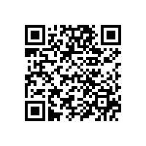
Suitable Code

